Slide 1

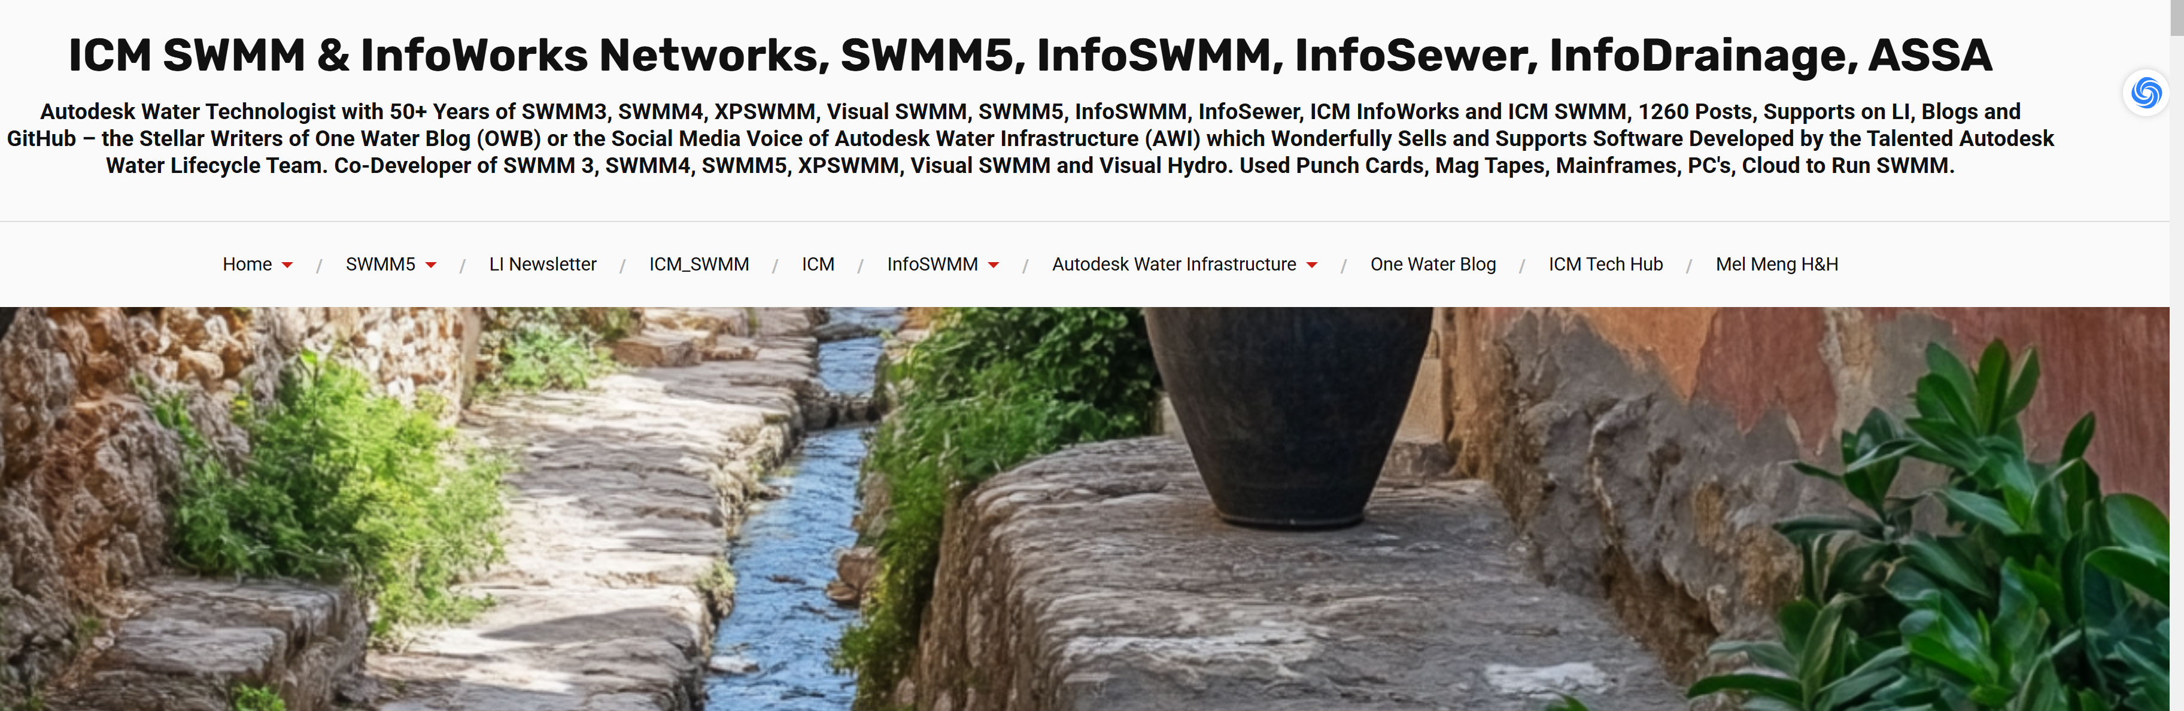
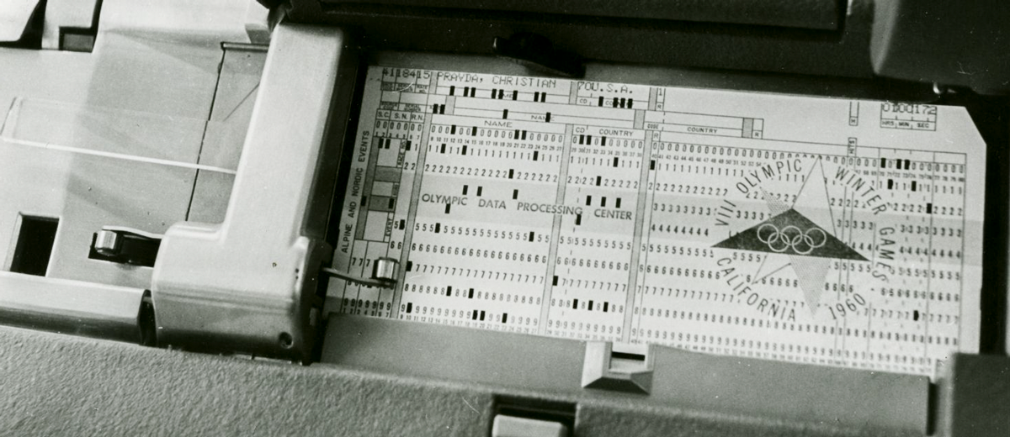


Punch Cards to Processors: The Evolution of Hydraulic Modeling and Numerical Solvers with a Focus on SWMM 1,2,3,4,5+
Robert E Dickinson and Many Others
Date: January 31, 2025
Notes:
For a 30-minute presentation on this subject, an ideal number of slides would range from 15 to 20, depending on the depth of content per slide and your speaking style. Here's the reasoning behind this estimate:
1. Factors to Consider
Speaking Pace:
On average, presenters spend 1.5–2 minutes per slide, depending on the slide complexity and their familiarity with the material.
Content Depth:
Some slides, like introductory and transition slides, will only require 30 seconds to 1 minute.
Code examples and technical explanations may require 2–3 minutes per slide.
Engagement Balance:
To maintain audience engagement, avoid overwhelming them with too much detail on one slide.
Use visuals (e.g., diagrams, graphs, timelines) to complement spoken explanations.
SWMM5 Code Examples:
Code slides take slightly longer to explain and may require highlighting specific lines or logic. Allocate more time to these slides.

Slide 2

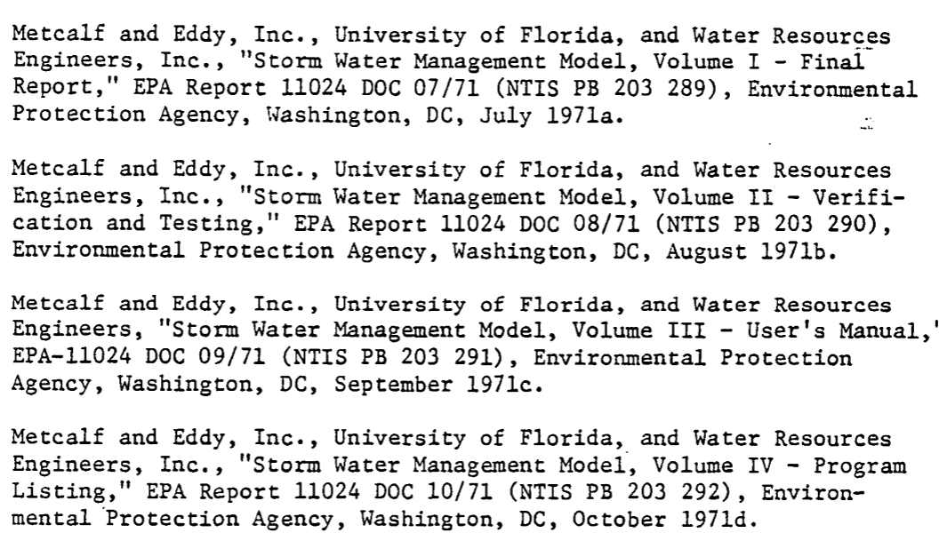
RED Bio Autodesk Water Technologist for Storm Sewer and Flood | Expert in ICM InfoWorks ICM SWMM/Ruby | 18 Years at Innovyze/Autodesk | 51 Years with EPASWMM
Robert Dickinson is a civil engineer recognized for his expertise in the U.S. EPA’s Storm Water Management Model (SWMM). He has contributed to the software’s development and refinement over several decades, helping shape many of SWMM5’s core functionalities. At Innovyze and now Autodesk (formerly MWH Soft), he led efforts to integrate SWMM-based solutions into advanced water infrastructure modeling tools. Dickinson regularly publishes technical articles, user guides, and best practices that benefit the global SWMM5 community. His longstanding dedication and practical insights continue to influence modern stormwater modeling and urban drainage management.
Notes:
2. Slide Count by Section
Here’s a breakdown of slides by topic and estimated time:
Section Slides Minutes Introduction 2 3 Early Hydraulic Modeling (Punch Cards) 2 3 The Emergence of SWMM 3 5 SWMM Evolution (SWMM3–SWMM5+) 5 8 Numerical Methods and Solvers 2 3 AI and SWMM Integration 3 5 Commercial Tools (InfoWorks, PCSWMM) 2 3 Future Directions and Summary 2 3 Total 21 30 3. Code Example Slides
Include 2–3 slides with SWMM5 code:
Simple Input File: Show an example of SWMM5 input file structure.
Numerical Solver Example: Highlight DYNWAVE routing or controls like RTC rules.
AI Integration Concept: Include a visual of how AI could interact with SWMM (e.g., parameter optimization).
4. Additional Tips
Keep 1-2 slides as buffer: Plan for minor overrun or flexibility if questions arise mid-presentation.
Transition Slides: Use minimal-text slides to signal shifts in topic (e.g., SWMM4 → SWMM5).
Final Estimate
A well-structured presentation for this topic would need 18–21 slides to balance technical depth, pacing, and audience engagement.

Slide 3
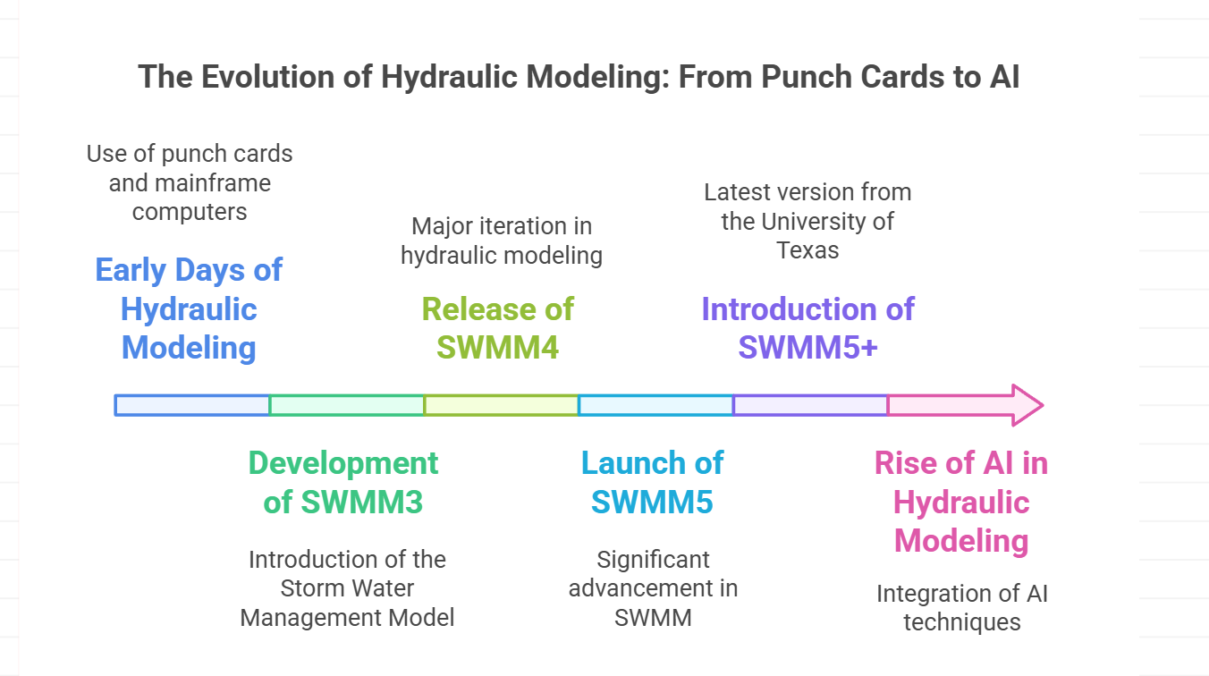

3 Themes, SWMM History, AI and OpenSWMM
This presentation traces the remarkable journey of hydraulic modeling from its early days of punch card and mainframe computers to today's sophisticated, AI-enhanced software solutions. We explore the development of the Storm Water Management Model (EPASWMM), a cornerstone in urban hydrology and hydraulics, through its major iterations: SWMM3, SWMM4, SWMM5, and the recent SWMM5+ from the University of Texas. The evolution of SWMM serves as a microcosm for broader advancements in hydraulic modeling and numerical methods. We examine how improvements in computational power and numerical techniques have enabled increasingly complex and accurate simulations.

Slide 4
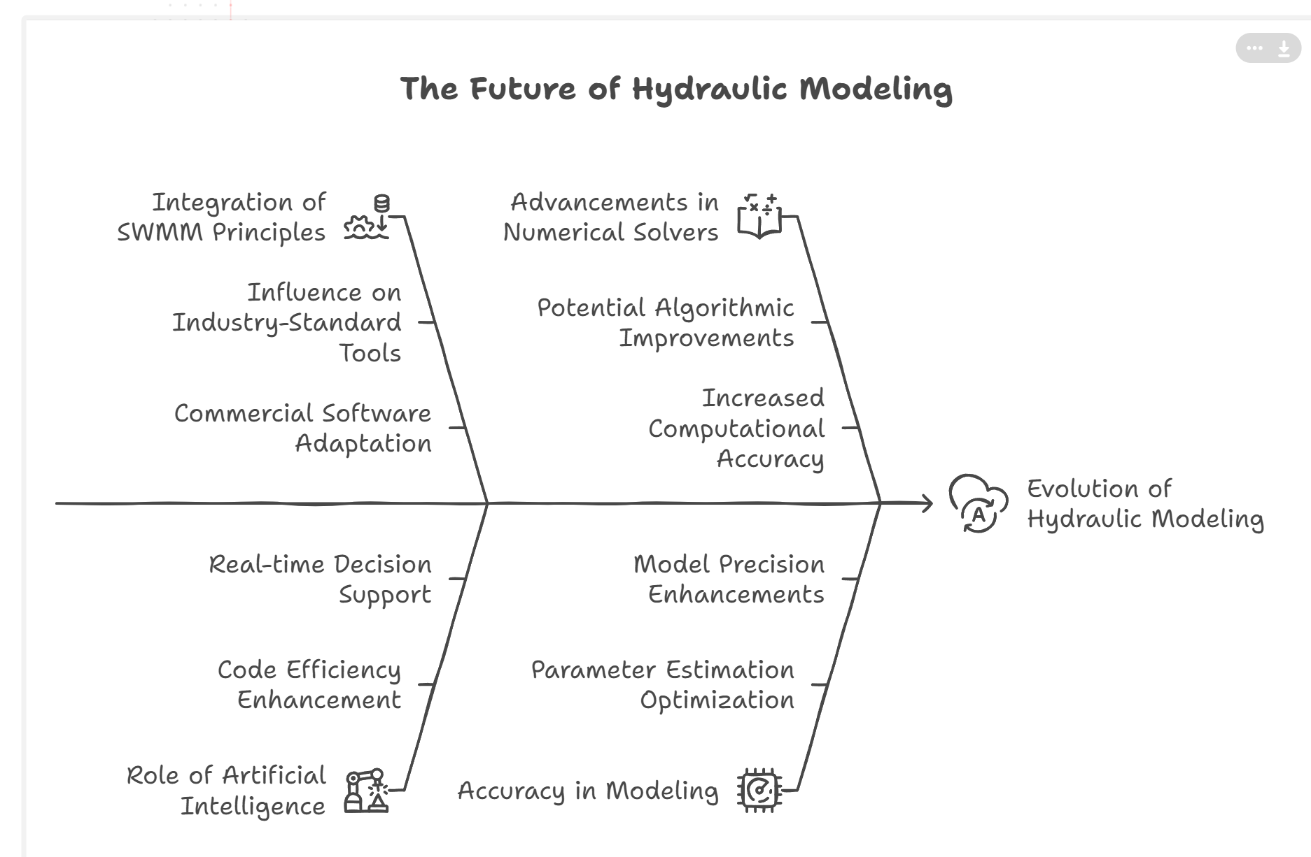
3 Themes, SWMM History, AI and OpenSWMM
Special attention is given to the integration of SWMM principles into commercial software like InfoWorks ICM, highlighting the model's influence on industry-standard tools. Furthermore, we discuss the rising role of artificial intelligence in hydraulic modeling. From enhancing code efficiency to optimizing parameter estimation and enabling real-time decision support systems, AI is reshaping how we approach hydraulic challenges. This intersection of traditional hydraulic theory with cutting-edge AI techniques represents the frontier of our field. By understanding this evolutionary path, we gain insights into future directions for hydraulic modeling, including potential advancements in numerical solvers, further AI integration, and the ongoing quest for more accuracy.

Slide 5
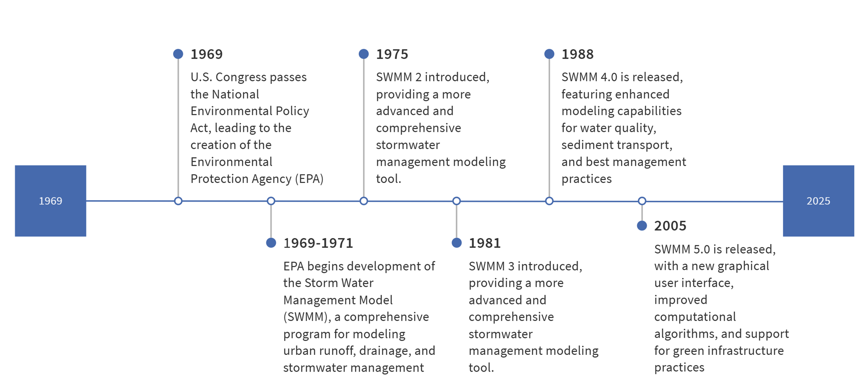
History of EPA SWMM
Notes:
Origins (Early 1970s)
1971: SWMM was first developed by the U.S. Environmental Protection Agency (EPA) as part of efforts to address water pollution under the Clean Water Act. The initial goal was to model combined sewer systems (CSOs) and urban runoff to mitigate pollution and flooding.
Collaborators: Key contributors included researchers like Dr. Wayne Huber (Oregon State University) and Dr. Robert E. Dickinson (later at CDM Smith), alongside EPA engineers. Early versions (SWMM 1 and 2) were written in Fortran and focused on hydrology, hydraulics, and rudimentary water quality.
Expansion and Refinement (1980s–1990s)
1980s: SWMM 3 and 4 introduced enhanced capabilities, including improved algorithms for flow routing (e.g., dynamic wave modeling) and water quality simulations (e.g., pollutant buildup/washoff).
1988: SWMM 4.4 became a landmark release, widely adopted for its comprehensive features. It remained in use for decades despite later updates.

Slide 6
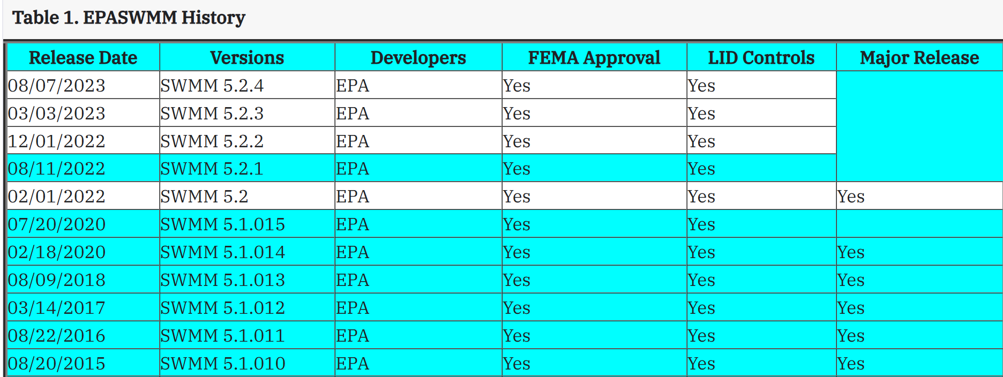
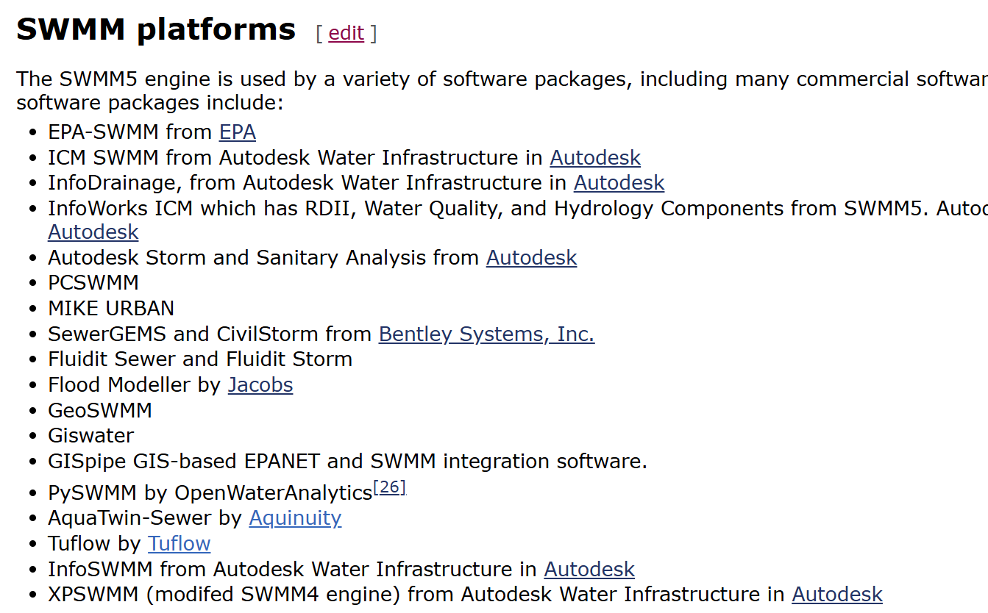
EPA SWMM VERSIONS and Platforms

Slide 7
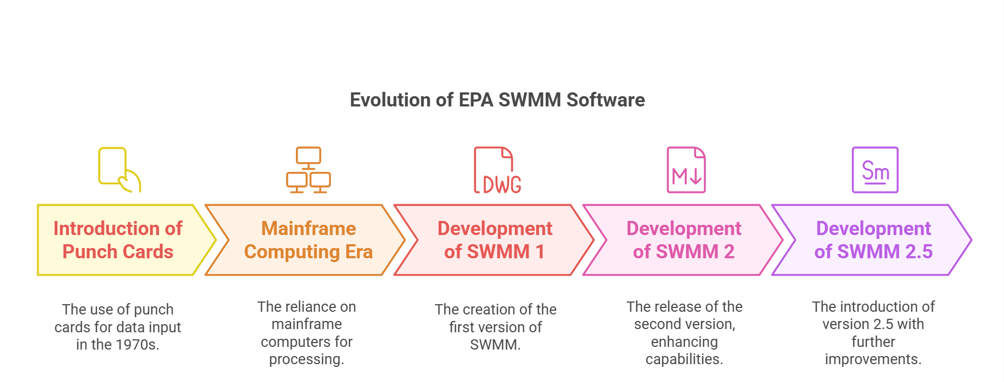
EPA SWMM In the 1970s

Slide 8
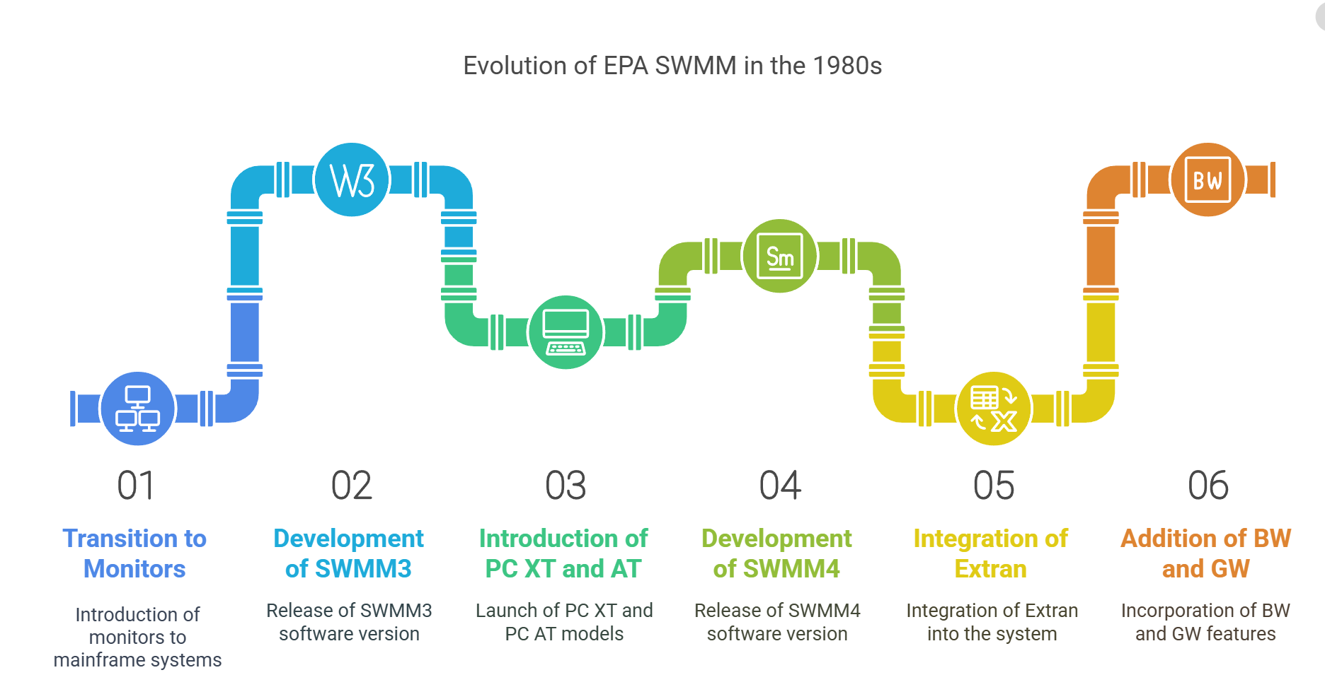
EPA SWMM In the 1980s

Slide 9
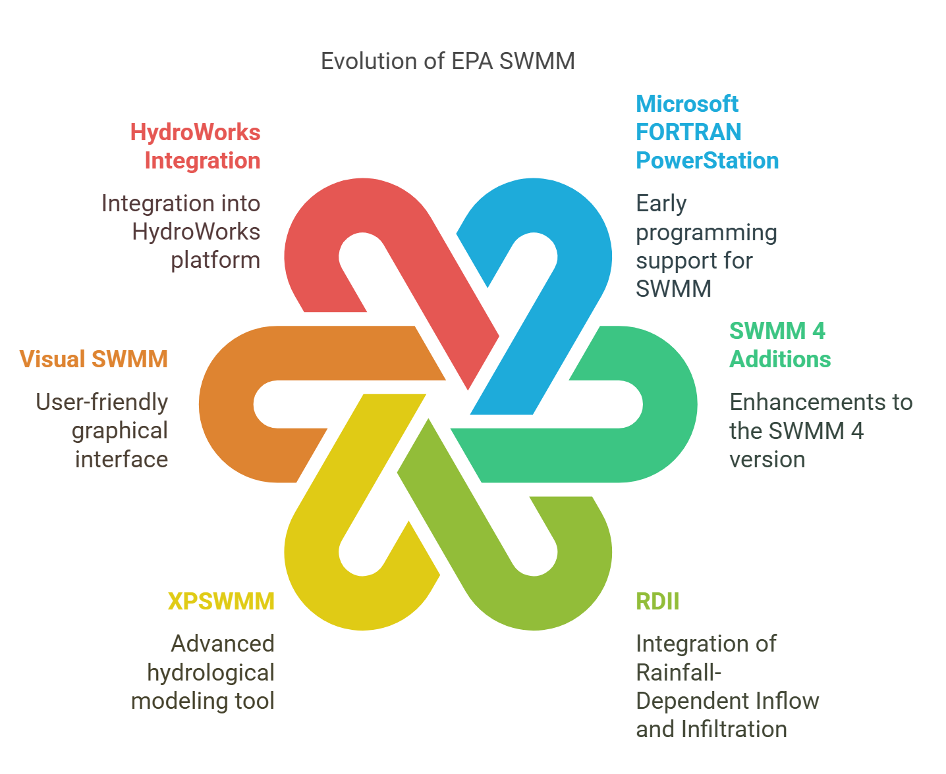
EPA SWMM In the 1990s

Slide 10
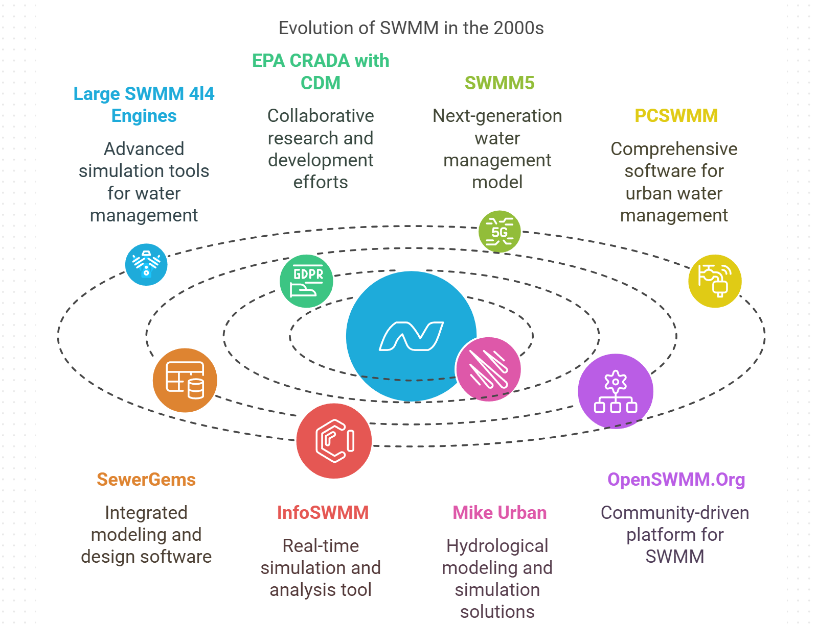
EPA SWMM In the 2000s

Slide 11
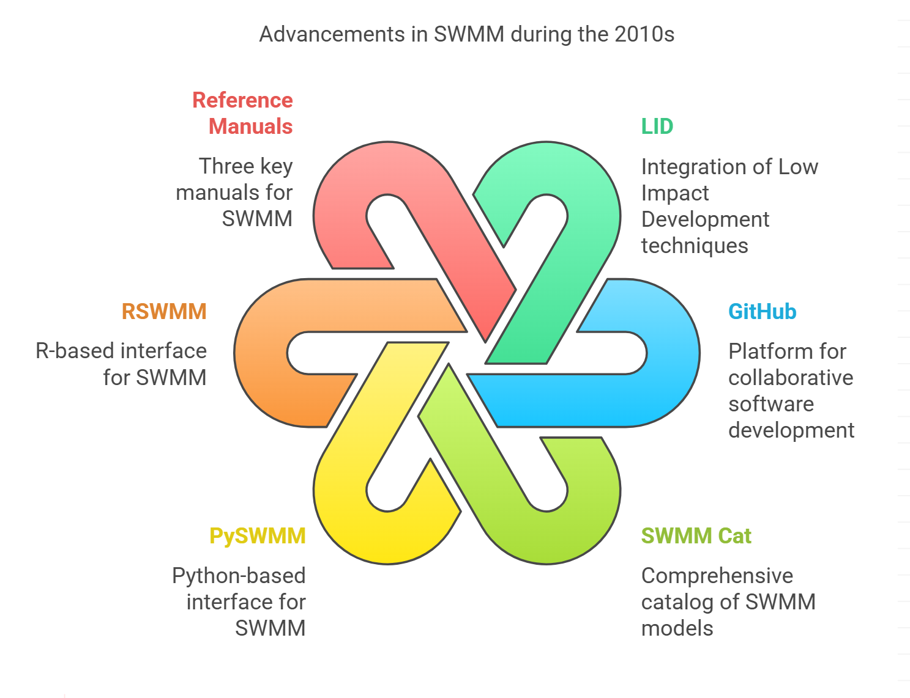
EPA SWMM In the 2010s

Slide 12
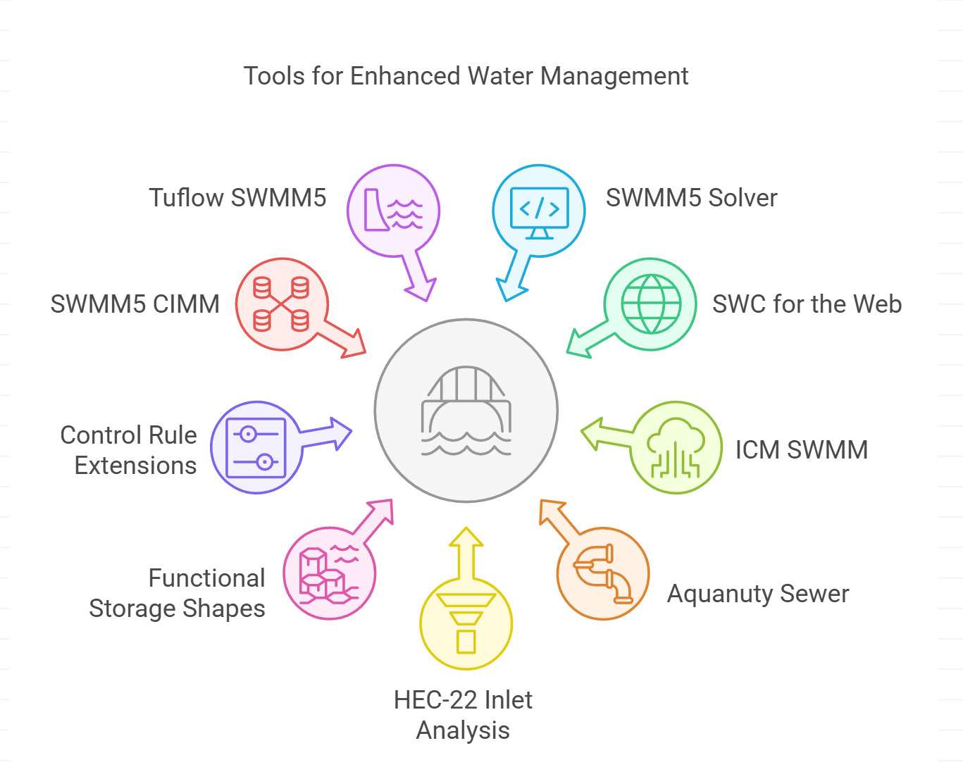
EPA SWMM In the 2020s
epaswmm5.exe -- the Windows user interface for SWMM 5
swmm5.dll -- the SWMM 5 computational engine
vcomp140.dll -- Microsoft® C/C++ OpenMP Runtime
runswmm.exe -- the command line version of SWMM 5
UserGuide.chm -- the SWMM 5 User Guide as a Help file
BasicTutorial.chm -- an introductory tutorial for SWMM 5
InletsTutorial.chm -- a tutorial on modeling street inlets

Slide 13
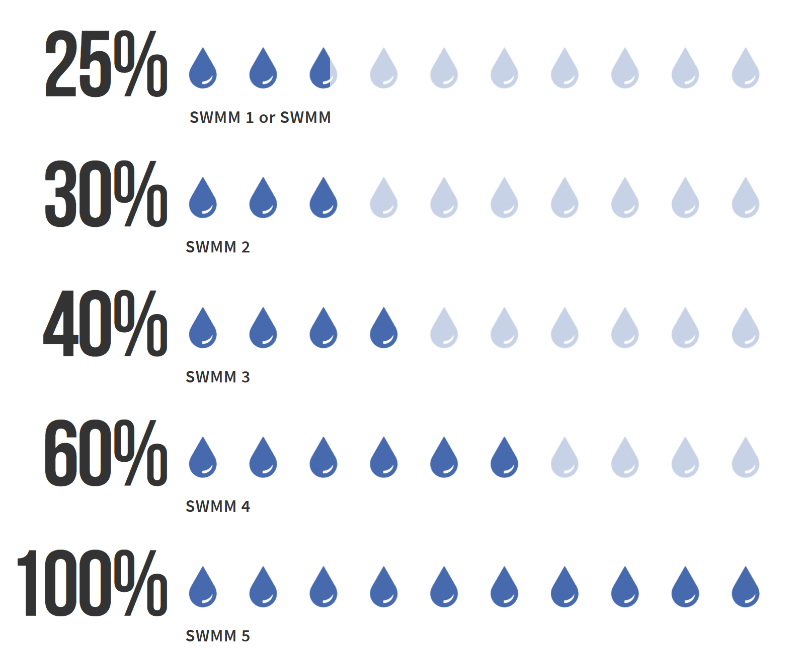
SWMM Version Grades
SWMM 1 (1971) is shown at around 25%, indicating its status as a foundational but limited first release.
SWMM 2 (1975) is at 30%, suggesting incremental improvements and refinements over Version 1.
SWMM 3 (late 1970s) is at 40%—more significant enhancements in both hydraulics and water quality features.
SWMM 4 (1980s–1990s) at 60%—further major expansions, refinements, and broader adoption.
SWMM 5 (2005 onward) at 100%—a reflection of the most comprehensive, modernized version with a user-friendly interface and robust modeling capabilities.
Notes:
Modernization (2000s–Present)
2004–2005: SWMM 5 was released as a complete rewrite in C/C++, led by Lewis Rossman (EPA) with contributions from the consulting firm CDM Smith. Key improvements included:
A user-friendly graphical interface (GUI).
Support for Low-Impact Development (LID) practices (e.g., green roofs, permeable pavements).
Real-time control and enhanced GIS integration.
2008: The open-source release of SWMM 5’s code spurred global collaboration, with researchers and engineers contributing extensions and updates.
2010s–Present: Continuous updates added features like climate resilience modeling, advanced water quality tools, and compatibility with other software (e.g., EPA’s SUSTAIN, PCSWMM, and SWMM+).

Slide 14
Fortran vs. Modern Languages
Why SWMM Evolved Beyond Fortran…
Fortran's Advantages:
Highly optimized for numerical and scientific computing
Simple syntax made it accessible for engineers and scientists
Limitations :
Highly optimized for numerical and scientific computing
Simple syntax made it accessible for engineers and scientists
SWMM's Evolution
Transition to C allowed integration with graphical interfaces and made the software more extensible

Slide 15
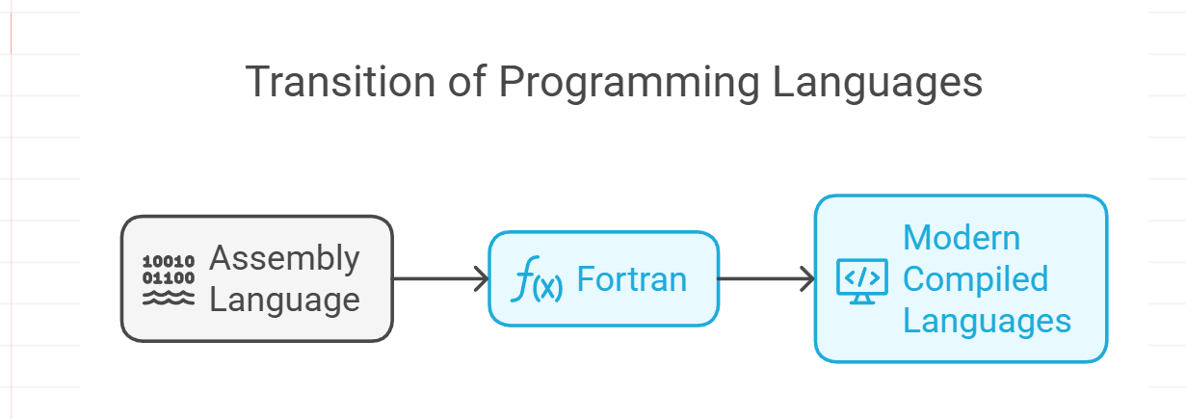
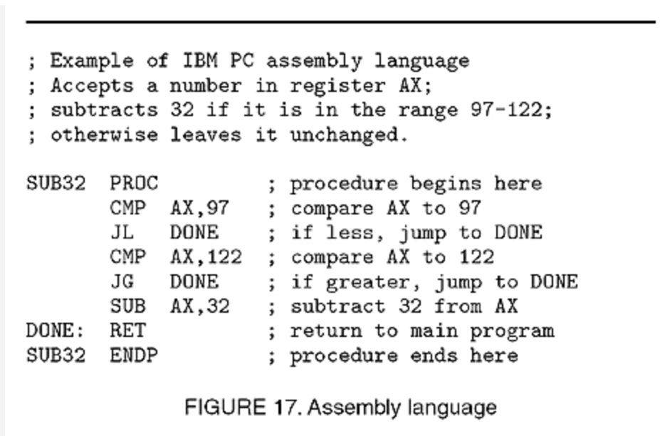
From Assembly to Fortran to C and C++
Why SWMM Evolved Beyond Fortran…
Title: The Evolution of Compilers: Enabling SWMM's Development
Content:
1950s–1960s: Scientists transitioned from manually coding in assembly to using Fortran. Compilers converted high-level code into machine language, improving productivity and reducing errors.
1970s–1990s: Advancements in compiler technology introduced languages like C and C++, enabling object-oriented programming and faster execution.
SWMM's Transition:
SWMM1–SWMM4 were developed in Fortran for its efficiency and widespread adoption in scientific computing.
SWMM5 (2005) was rewritten in C, leveraging modern compiler technologies for better performance, portability, and maintainability.

Slide 16
The Coming Golden ERA
SWMM Released in 1971
Faster Iteration and Feedback In 1971, every code change had to be typed onto punch cards, physically fed into a mainframe, then run through a queue. This cumbersome process meant that debugging or testing even a minor fix was laborious. Today, developers compile and run SWMM locally or in the cloud within seconds, rapidly debugging and refining the model.
SWMM Released in 1971
Robust Collaboration and Version Control In the punch‐card era, code management was essentially sharing decks of cards or printed listings—extremely prone to duplication, error, and confusion. Now, Git and other version control systems seamlessly track every change, making collaborative development straightforward and transparent. Multiple people can work on the same SWMM module simultaneously without overwriting each other’s progress.
SWMM Released in 1971
.
Integrated Development Environments and Testing Modern IDEs offer live error checking, syntax highlighting, and debugging tools that would have been unimaginable in 1971. Automated test suites, continuous integration (CI), and regression testing ensure consistent quality. Models can be validated daily or even hourly rather than waiting for a single mainframe batch run.
Notes:
The colored droplets represent how SWMM’s capabilities or completeness have grown across different versions. Each row corresponds to a specific SWMM release (Versions 1 through 5), with the percentage reflecting the model’s increasing feature set, maturity, or overall capability.
SWMM 1 (1971) is shown at around 25%, indicating its status as a foundational but relatively limited first release.
SWMM 2 (1975) is at 30%, suggesting incremental improvements and refinements over Version 1.
SWMM 3 (late 1970s) is at 40%—more significant enhancements in both hydraulics and water quality features.
SWMM 4 (1980s–1990s) at 60%—further major expansions, refinements, and broader adoption.
SWMM 5 (2005 onward) at 100%—a reflection of the most comprehensive, modernized version with a user-friendly interface and robust modeling capabilities.

Slide 17
The Coming Golden ERA
SWMM Released in 1971
Powerful Hardware and Cross-Platform Compatibility Early SWMM developers had to ration limited CPU time on large mainframes. Today’s developers have gigabytes of RAM, multi‐core processors, and cloud computing at their disposal. SWMM can be compiled and run on Windows, Mac, Linux, or in virtual environments, opening development to a broader ecosystem and user base.
SWMM Released in 1971
Open‐Source Community and Peer Review The modern open‐source ethos allows experts worldwide to examine, critique, and improve SWMM code in real time. This continuous feedback loop results in more stable, feature‐rich releases, whereas in 1971, modifications were typically limited to a small group of government or academic developers.
SWMM Released in 1971
.
Advanced Analysis and Data Visualization Once the model runs, modern plotting libraries, GIS integrations, and interactive dashboards allow immediate exploration of results. By comparison, the punch‐card era left users sifting through reams of printed output for debugging and data interpretation.
Notes:
The colored droplets represent how SWMM’s capabilities or completeness have grown across different versions. Each row corresponds to a specific SWMM release (Versions 1 through 5), with the percentage reflecting the model’s increasing feature set, maturity, or overall capability.
SWMM 1 (1971) is shown at around 25%, indicating its status as a foundational but relatively limited first release.
SWMM 2 (1975) is at 30%, suggesting incremental improvements and refinements over Version 1.
SWMM 3 (late 1970s) is at 40%—more significant enhancements in both hydraulics and water quality features.
SWMM 4 (1980s–1990s) at 60%—further major expansions, refinements, and broader adoption.
SWMM 5 (2005 onward) at 100%—a reflection of the most comprehensive, modernized version with a user-friendly interface and robust modeling capabilities.

Slide 18
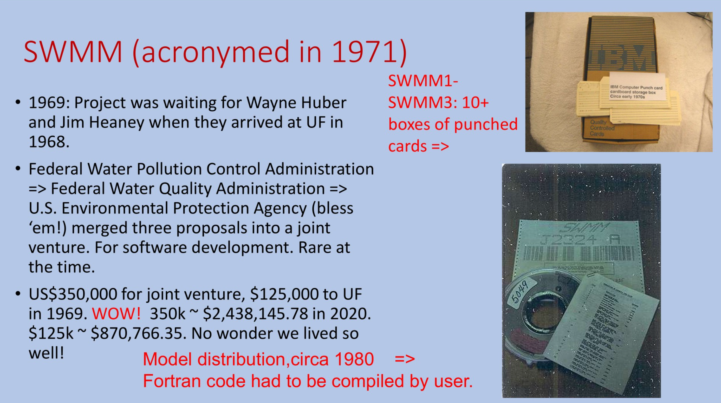
Early Hydraulic Modeling (Punch Cards)
SWMM Released in 1971
SWMM actually started before the founding of the EPA.
Establishment Parameters:
Date of Authorization: December 2, 1970
Executive Order: Reorganization Plan No. 3 of 1970
First Administrator: William Ruckelshaus
Initial Operating Authority: Executive branch agency
Organizational Integration of Pre-existing Programs:
Federal Water Quality Administration
Transfer Date: December 4, 1970
Origin: Department of Interior
Primary Functions: Water quality standards, discharge permits

Slide 19
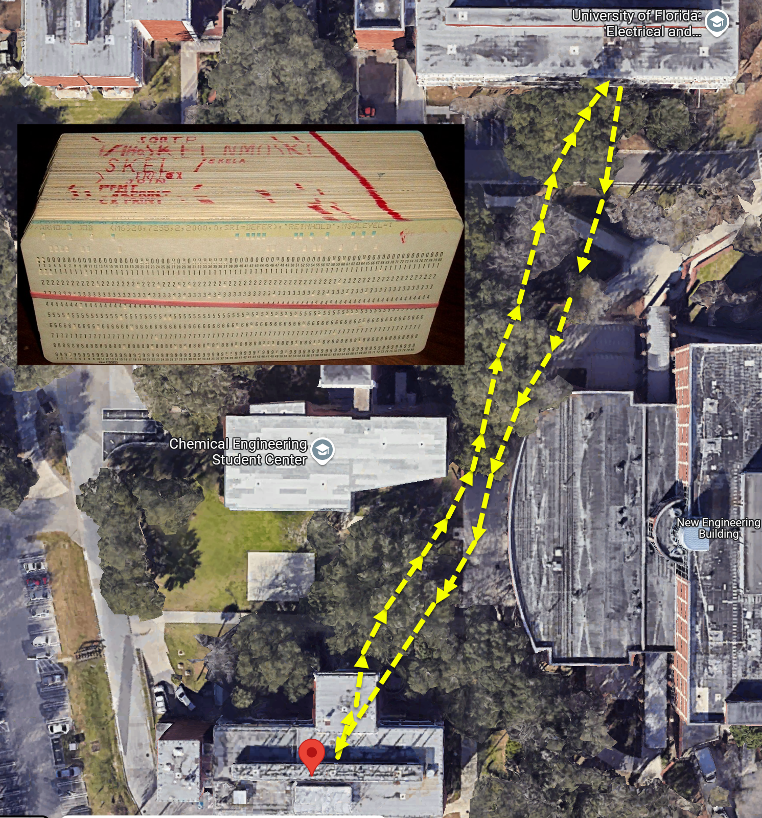
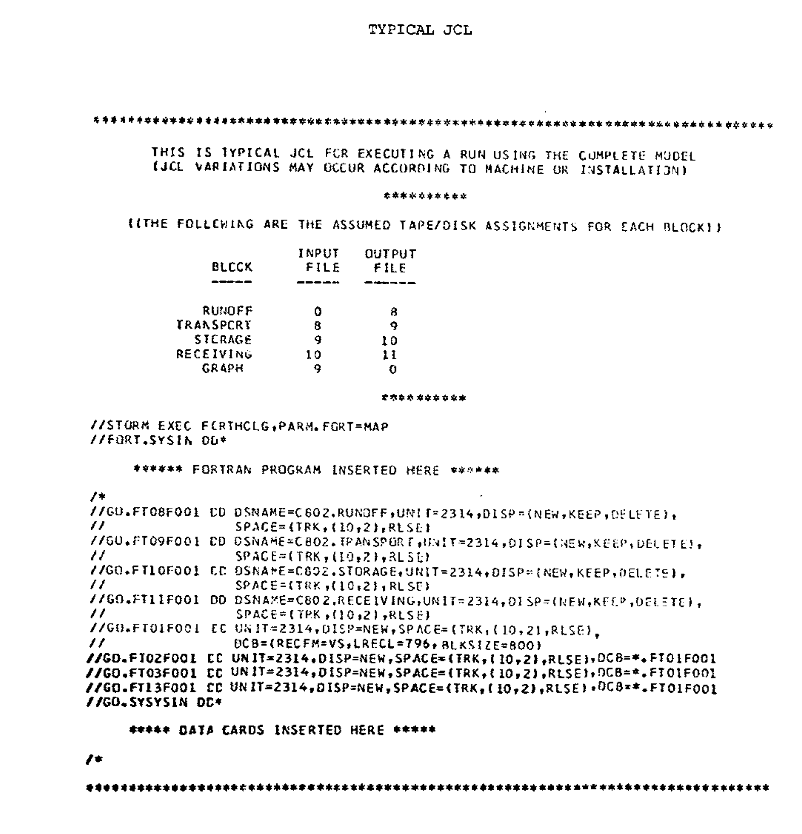
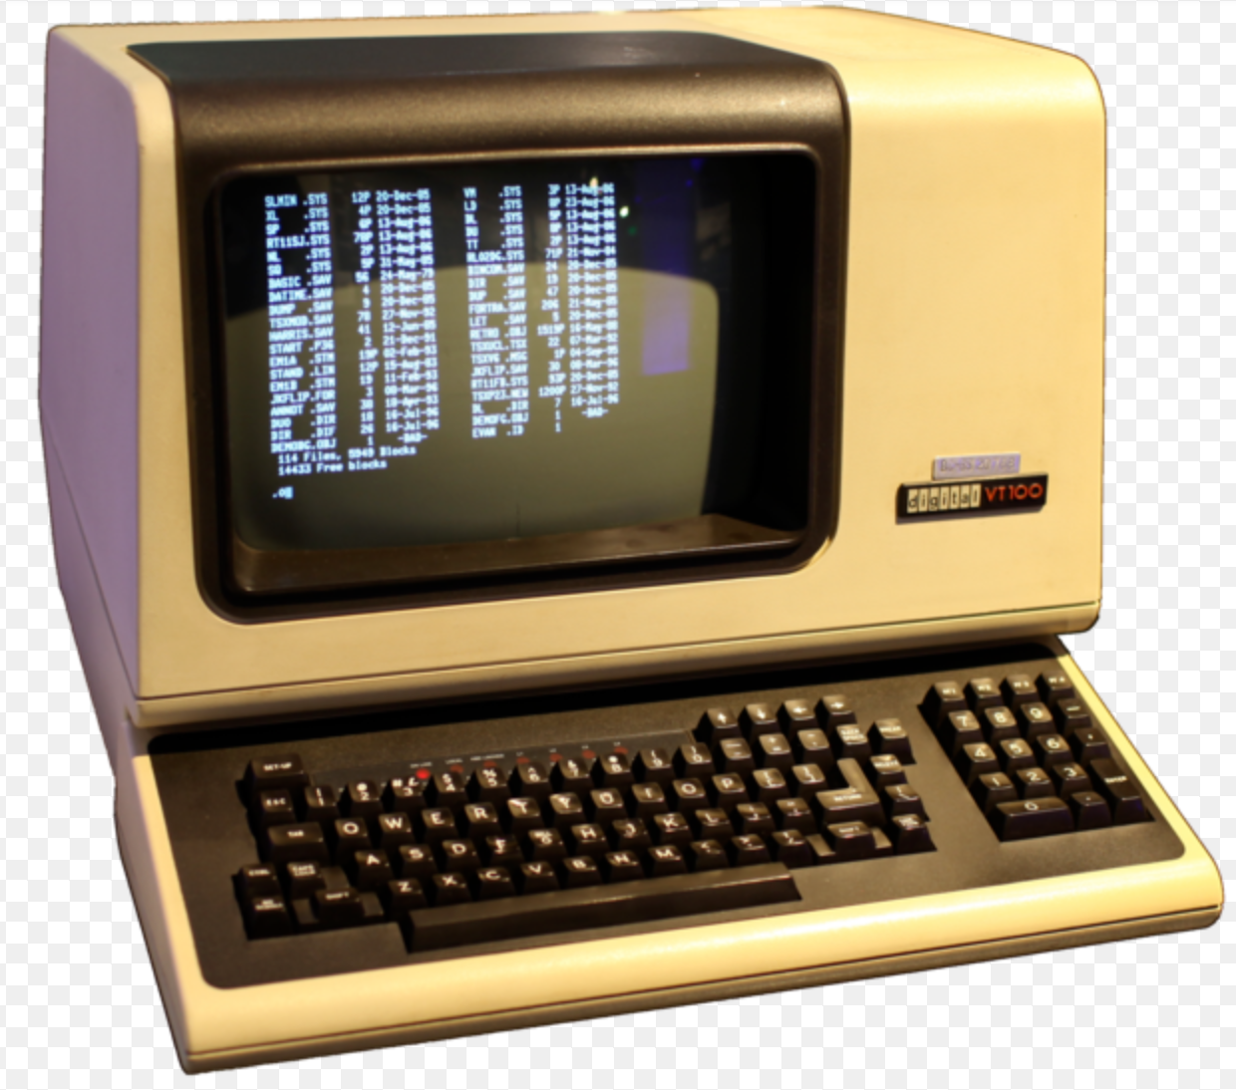
Emergence of SWMM3 Using Punch Cards
I measured this on Google Maps and it only 910 feet coming and going but it did include six flights of stairs caring one to three boxes of punch cards. This lasted from 1978 to sometime in 1980.
Moved to terminals in 1980
SWMM JCL

Slide 20
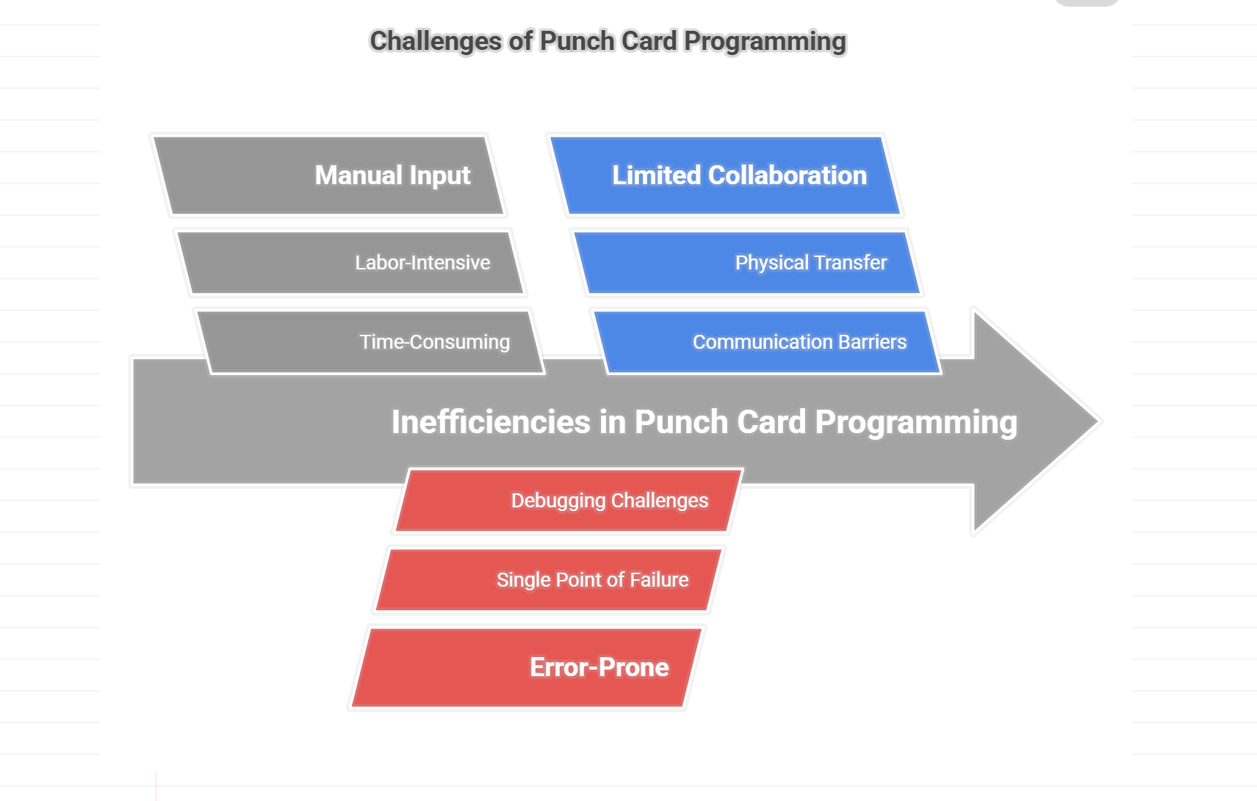
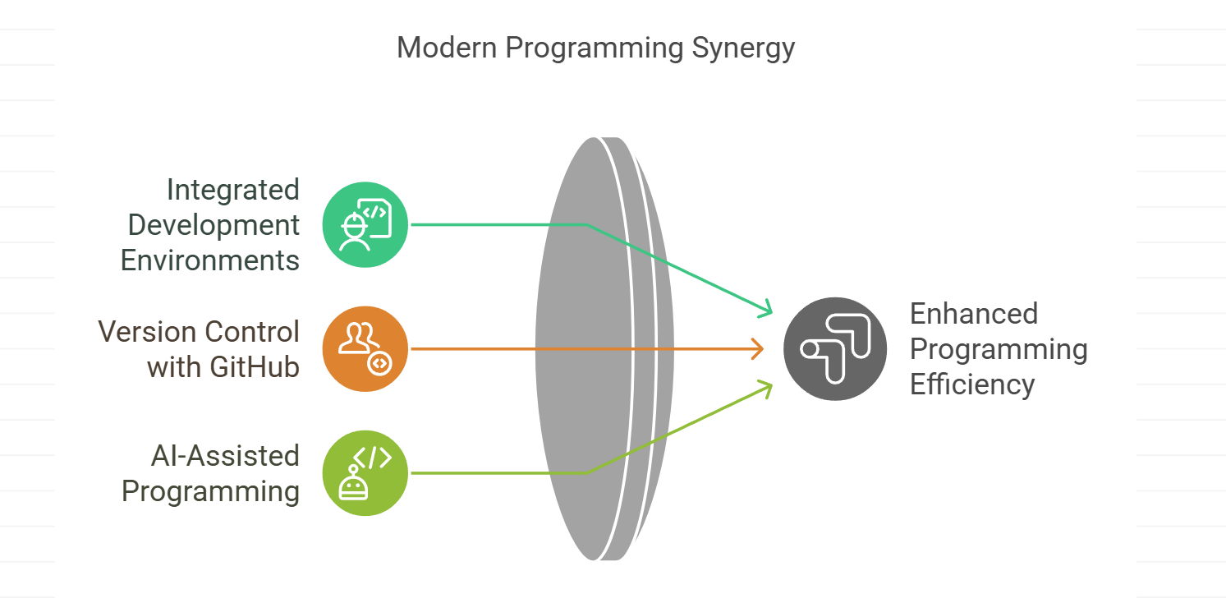
Punch Cards Era vs Modern Programming with SWMM5

Slide 21
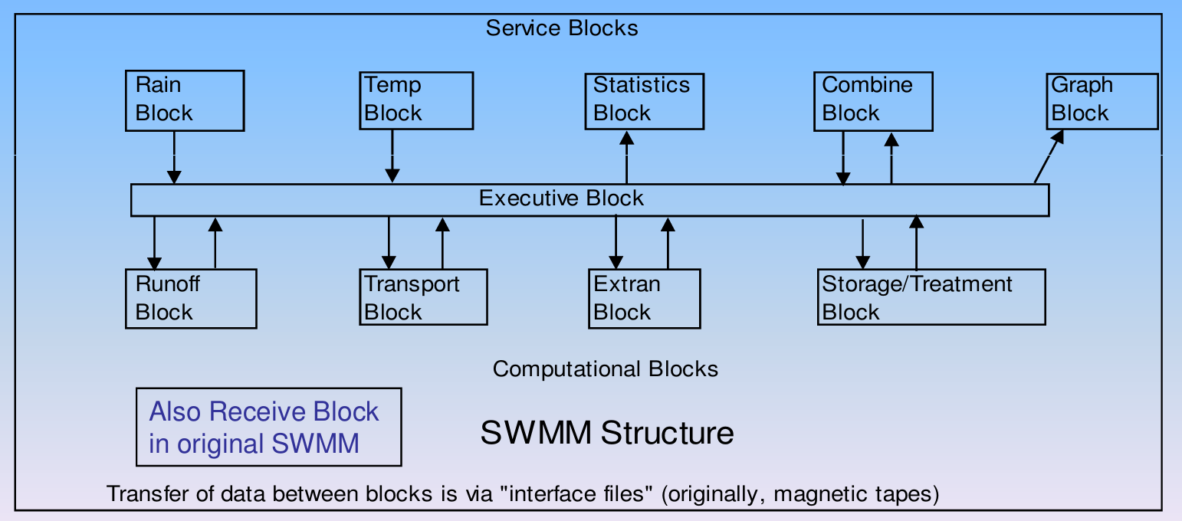
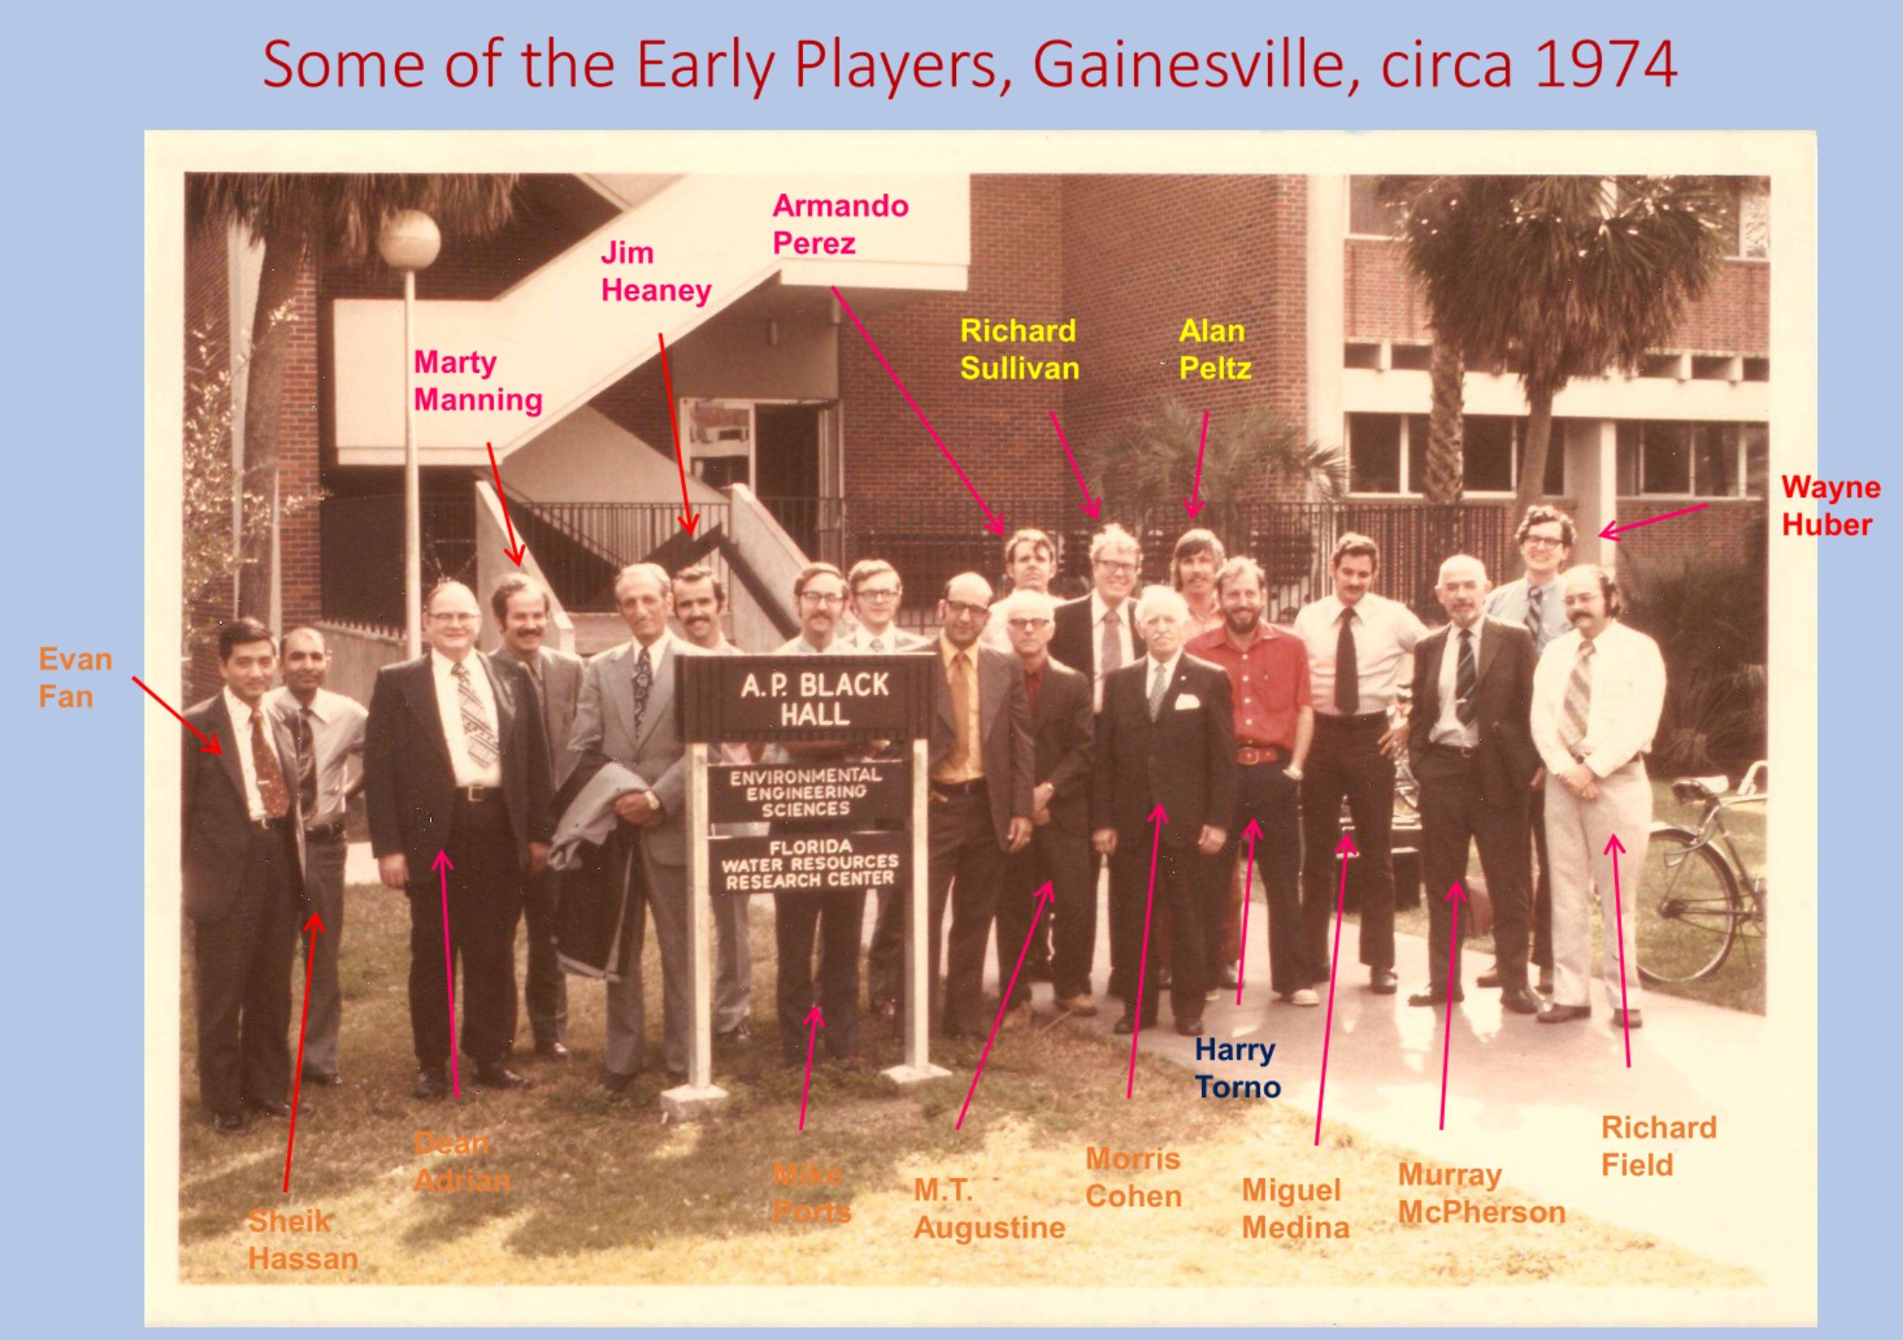
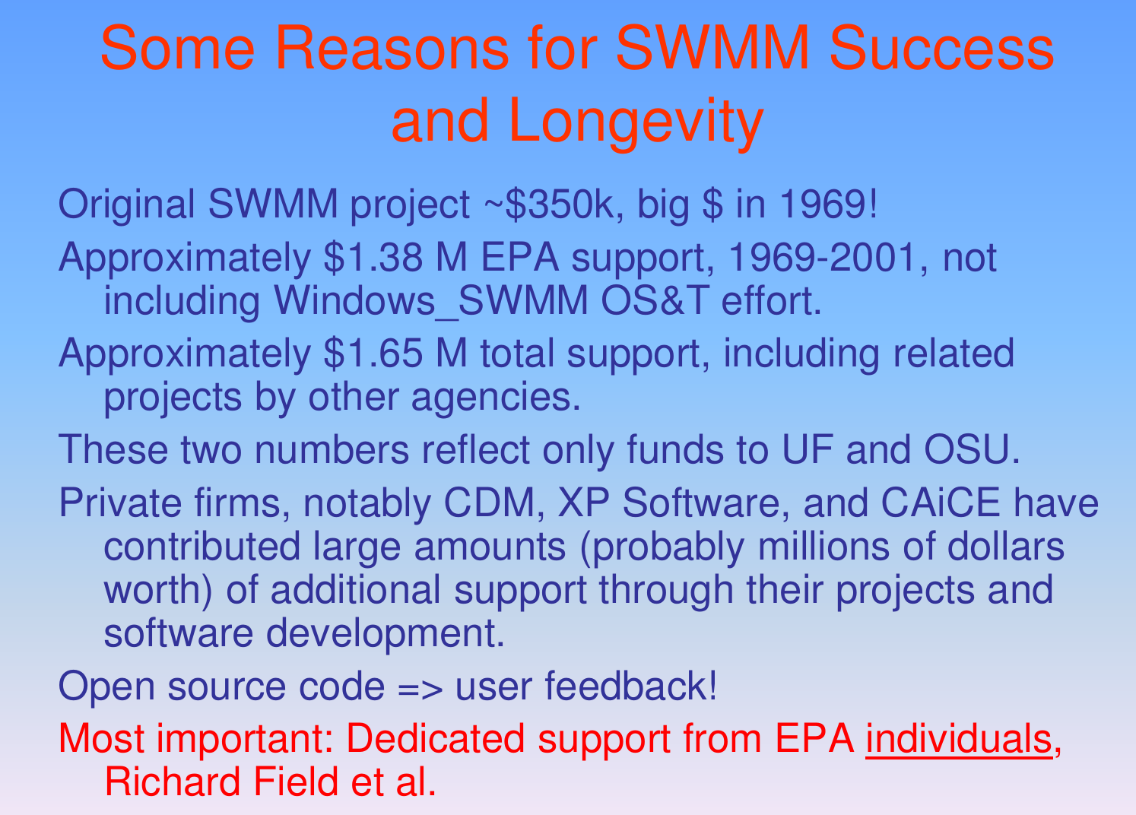
Where and Who Made SWMM1 and SWMM2

Slide 22
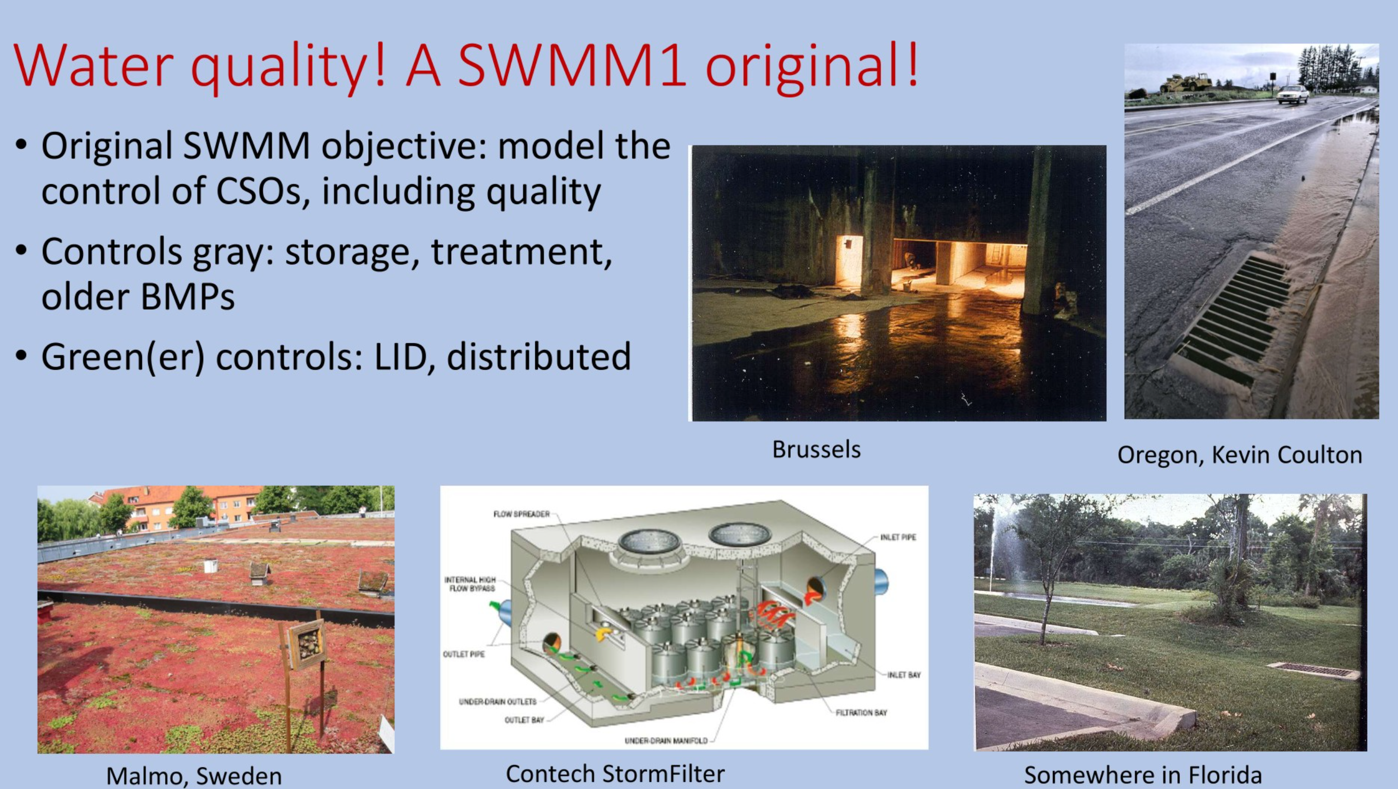
GI and SWMM1 – A Goal Not Achieved

Slide 23
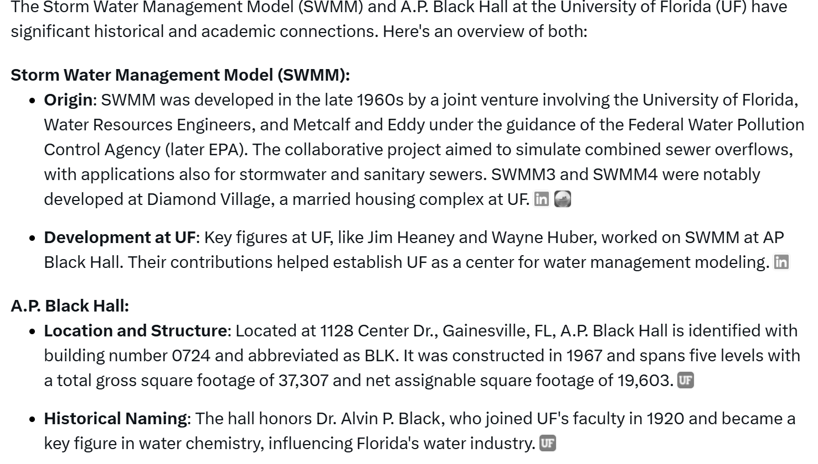
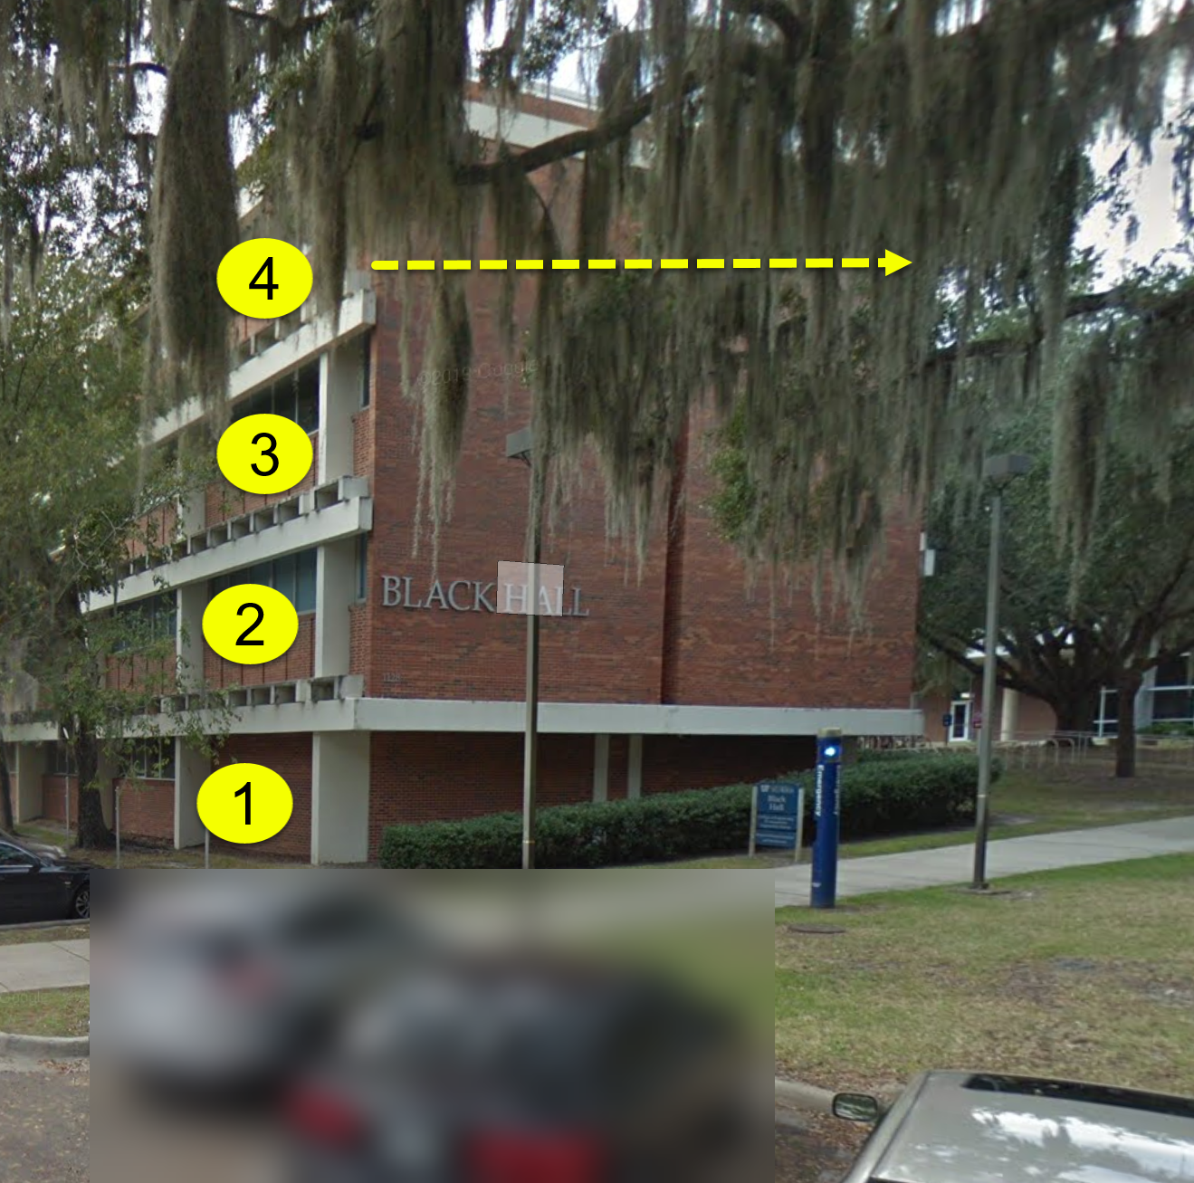
Home of SWMM 1,2,3,4 - 4th Floor AP Black Hall

Slide 24
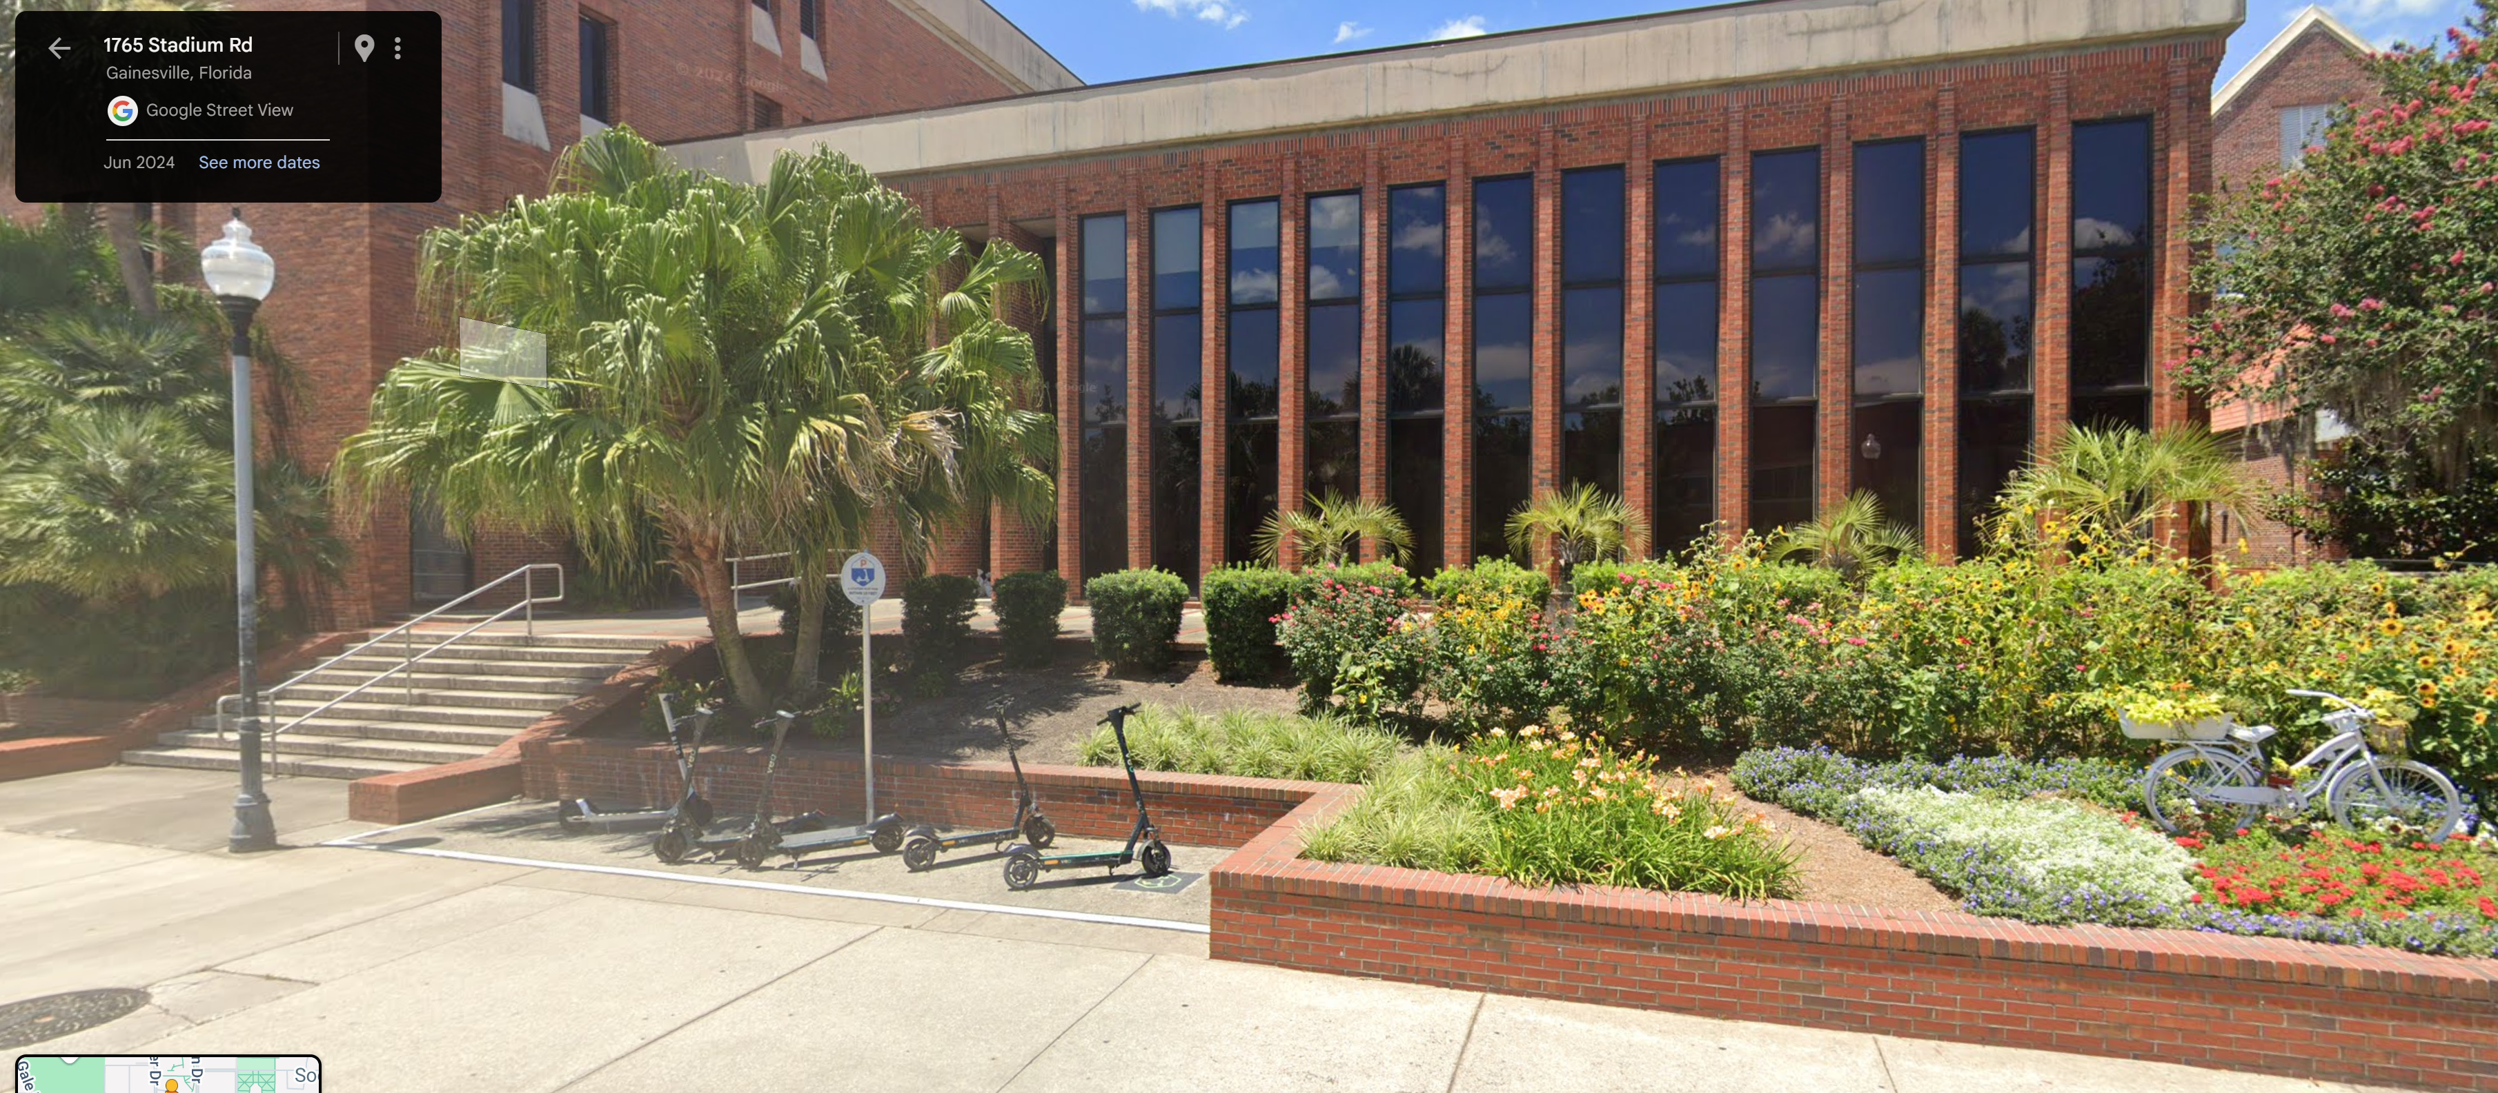
Mainframe used at UF NERDC for SWMM 3,4
Amdahl Mainframes at NERDC: In 1977, NERDC upgraded its computing capabilities by replacing its existing IBM 360/165 with an Amdahl 470/V6 mainframe. This was a significant upgrade as the Amdahl 470/V6 was known for its higher performance, offering about 2.2 MIPS (Million Instructions Per Second) compared to the previous IBM model. This transition reflects the era when plug-compatible mainframes from companies like Amdahl were becoming viable alternatives to IBM systems, offering better price-performance ratios and air-cooling technology, which was different from IBM's water-cooled systems at the time.
PC Now > 150,000 - 500,000 MIPS

Slide 25
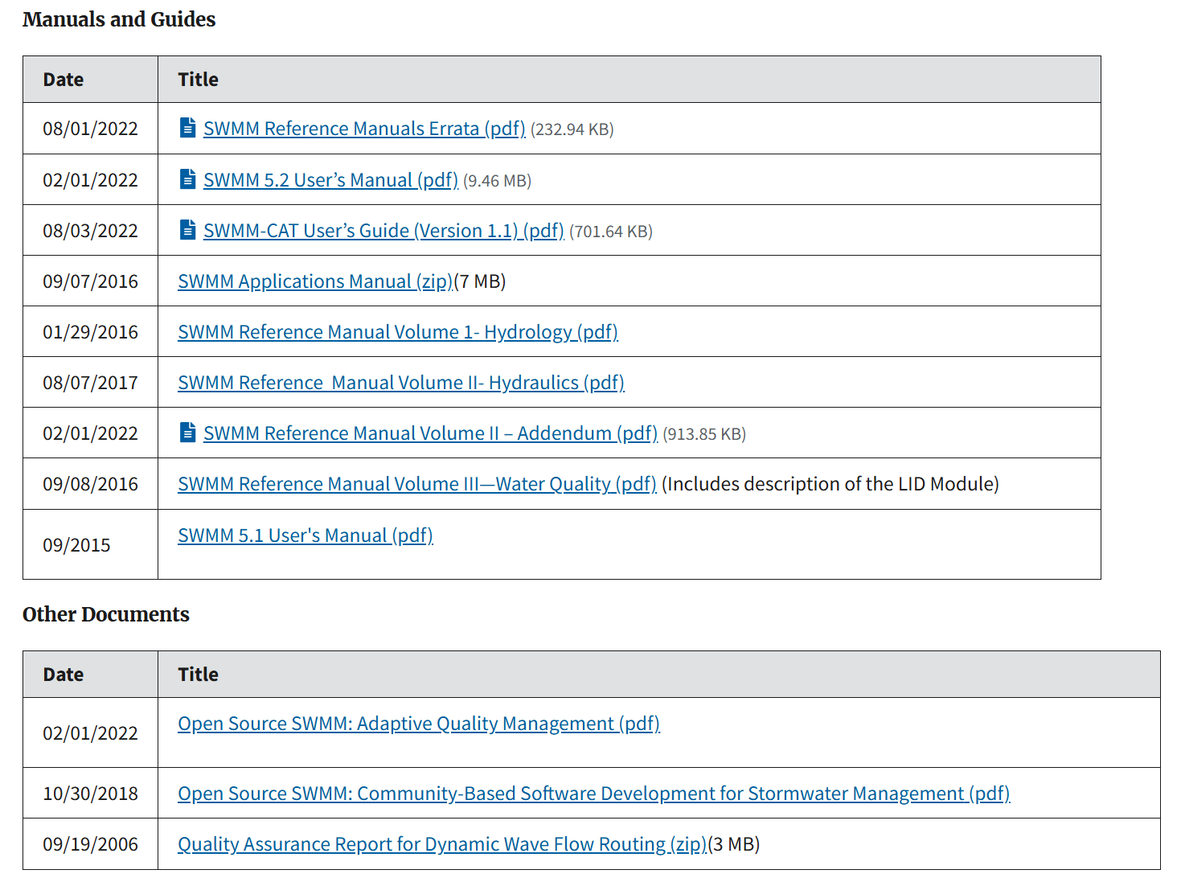
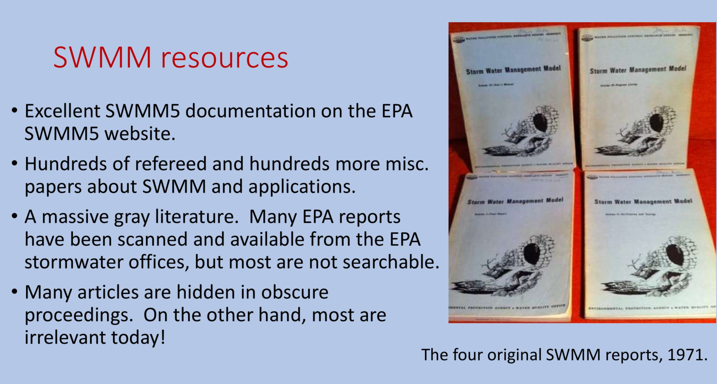
Excellent Reference Manuals for some SWMM Versions

Slide 26
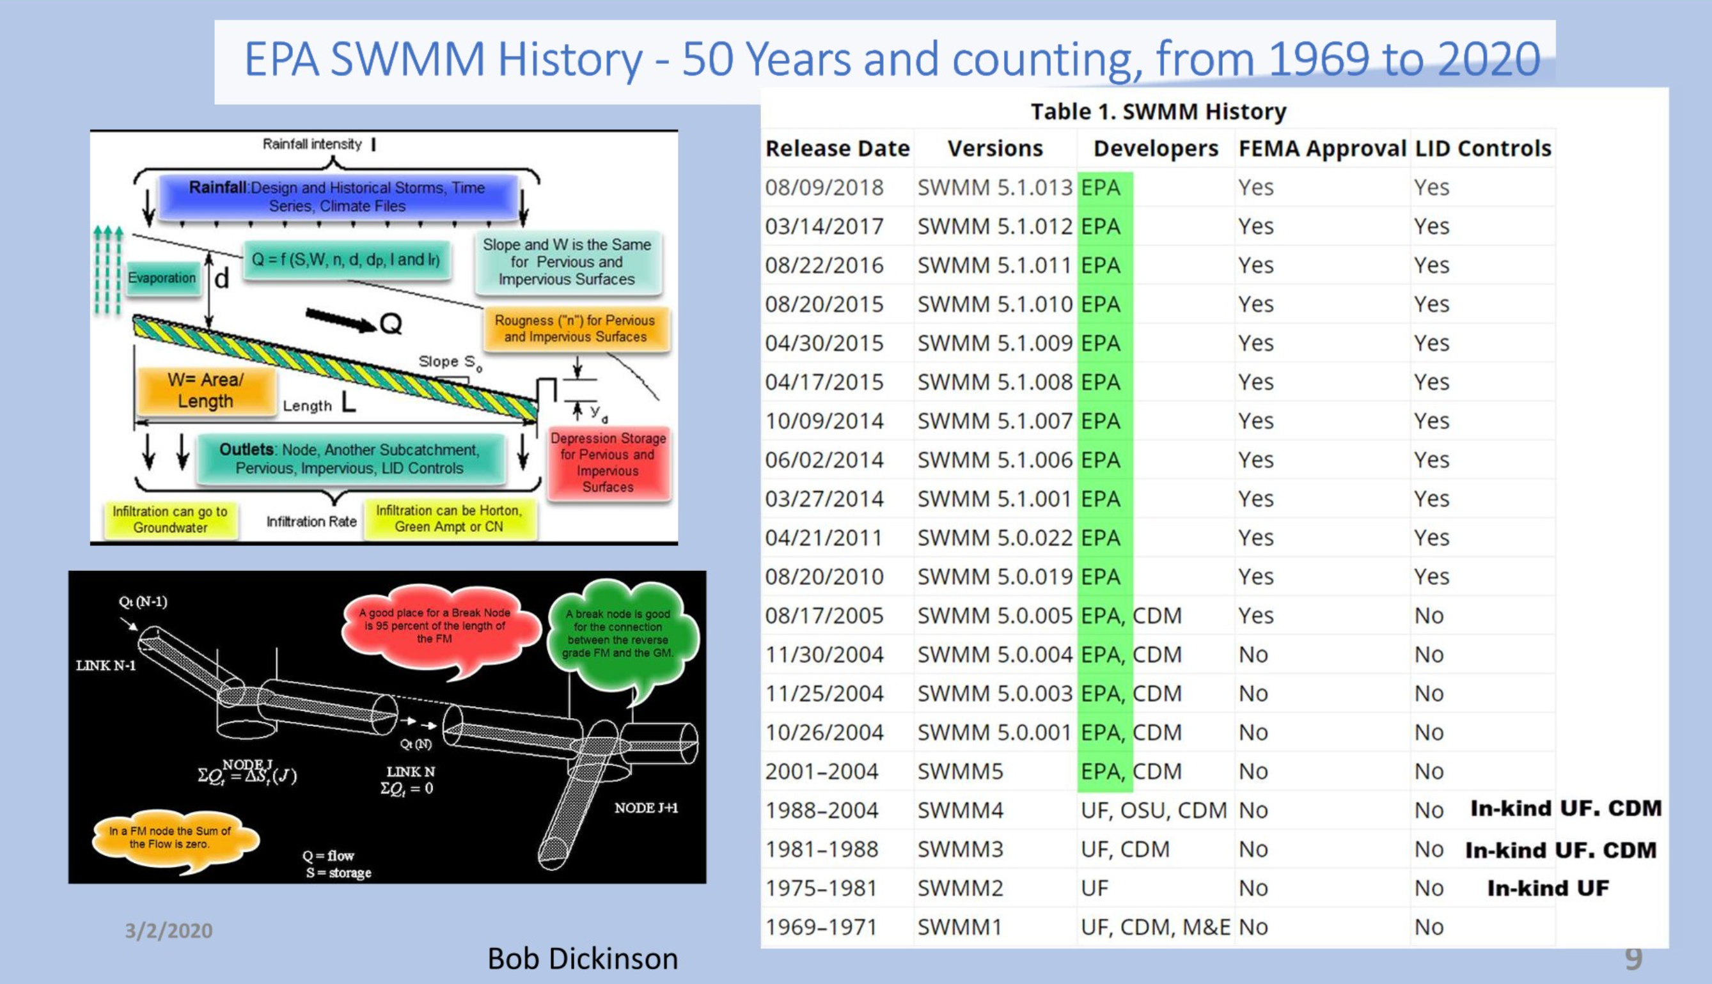
SWMM Evolution (SWMM3–SWMM5+)
Total SWMM versions: 50+ versions, considering all known releases and avoiding double-counting where possible. However, this number might be slightly higher due to undocumented minor updates or patch releases.

Slide 27
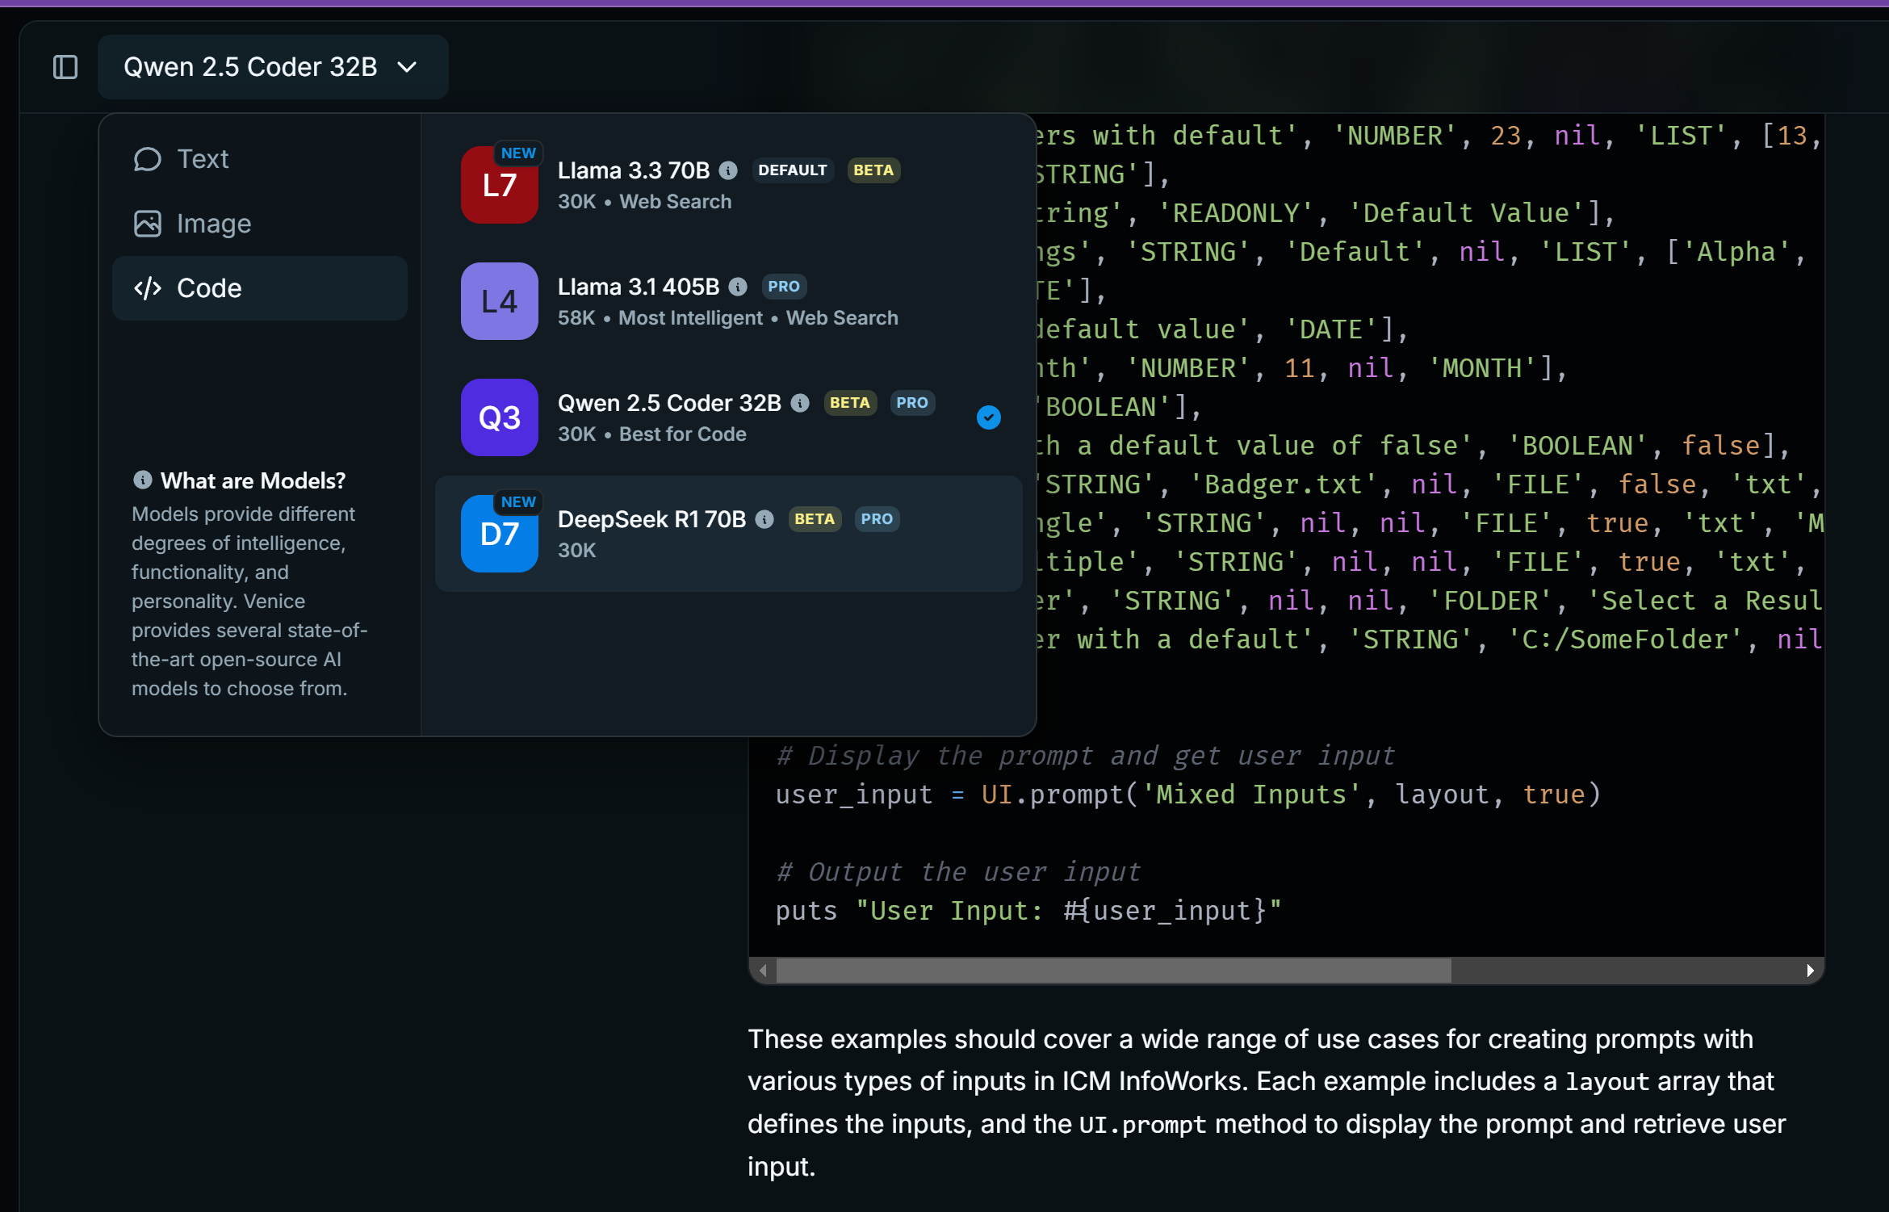
Many, many AI’s for Coding
IMO = all are good.

Slide 28
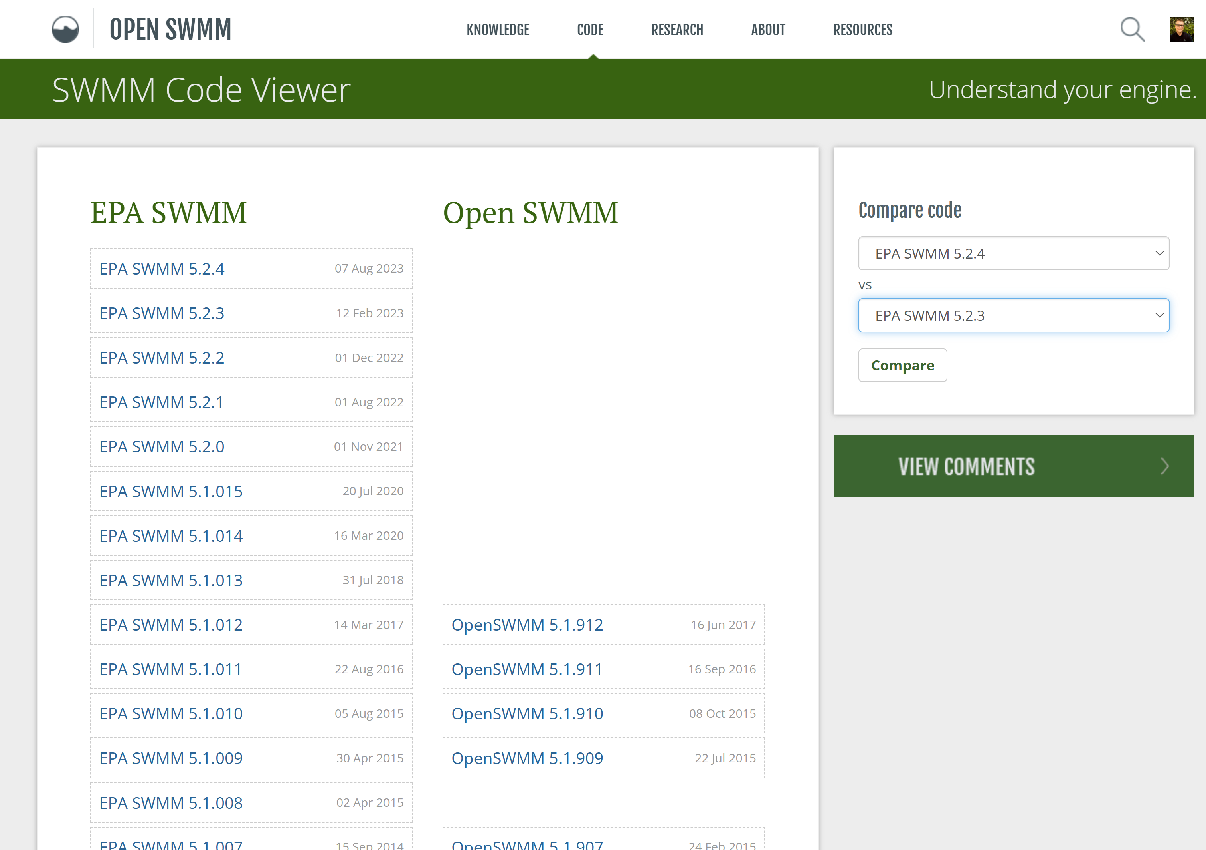
OpenSWMM.Org for Questions, Code and AI
OpenSWMM.org is a valuable resource for SWMM5.
Direct Access to Experienced Practitioners
Timely Updates on Software Quirks
Collaborative Problem-Solving
Archive of Practical Examples
Code-Level Transparency

Slide 29
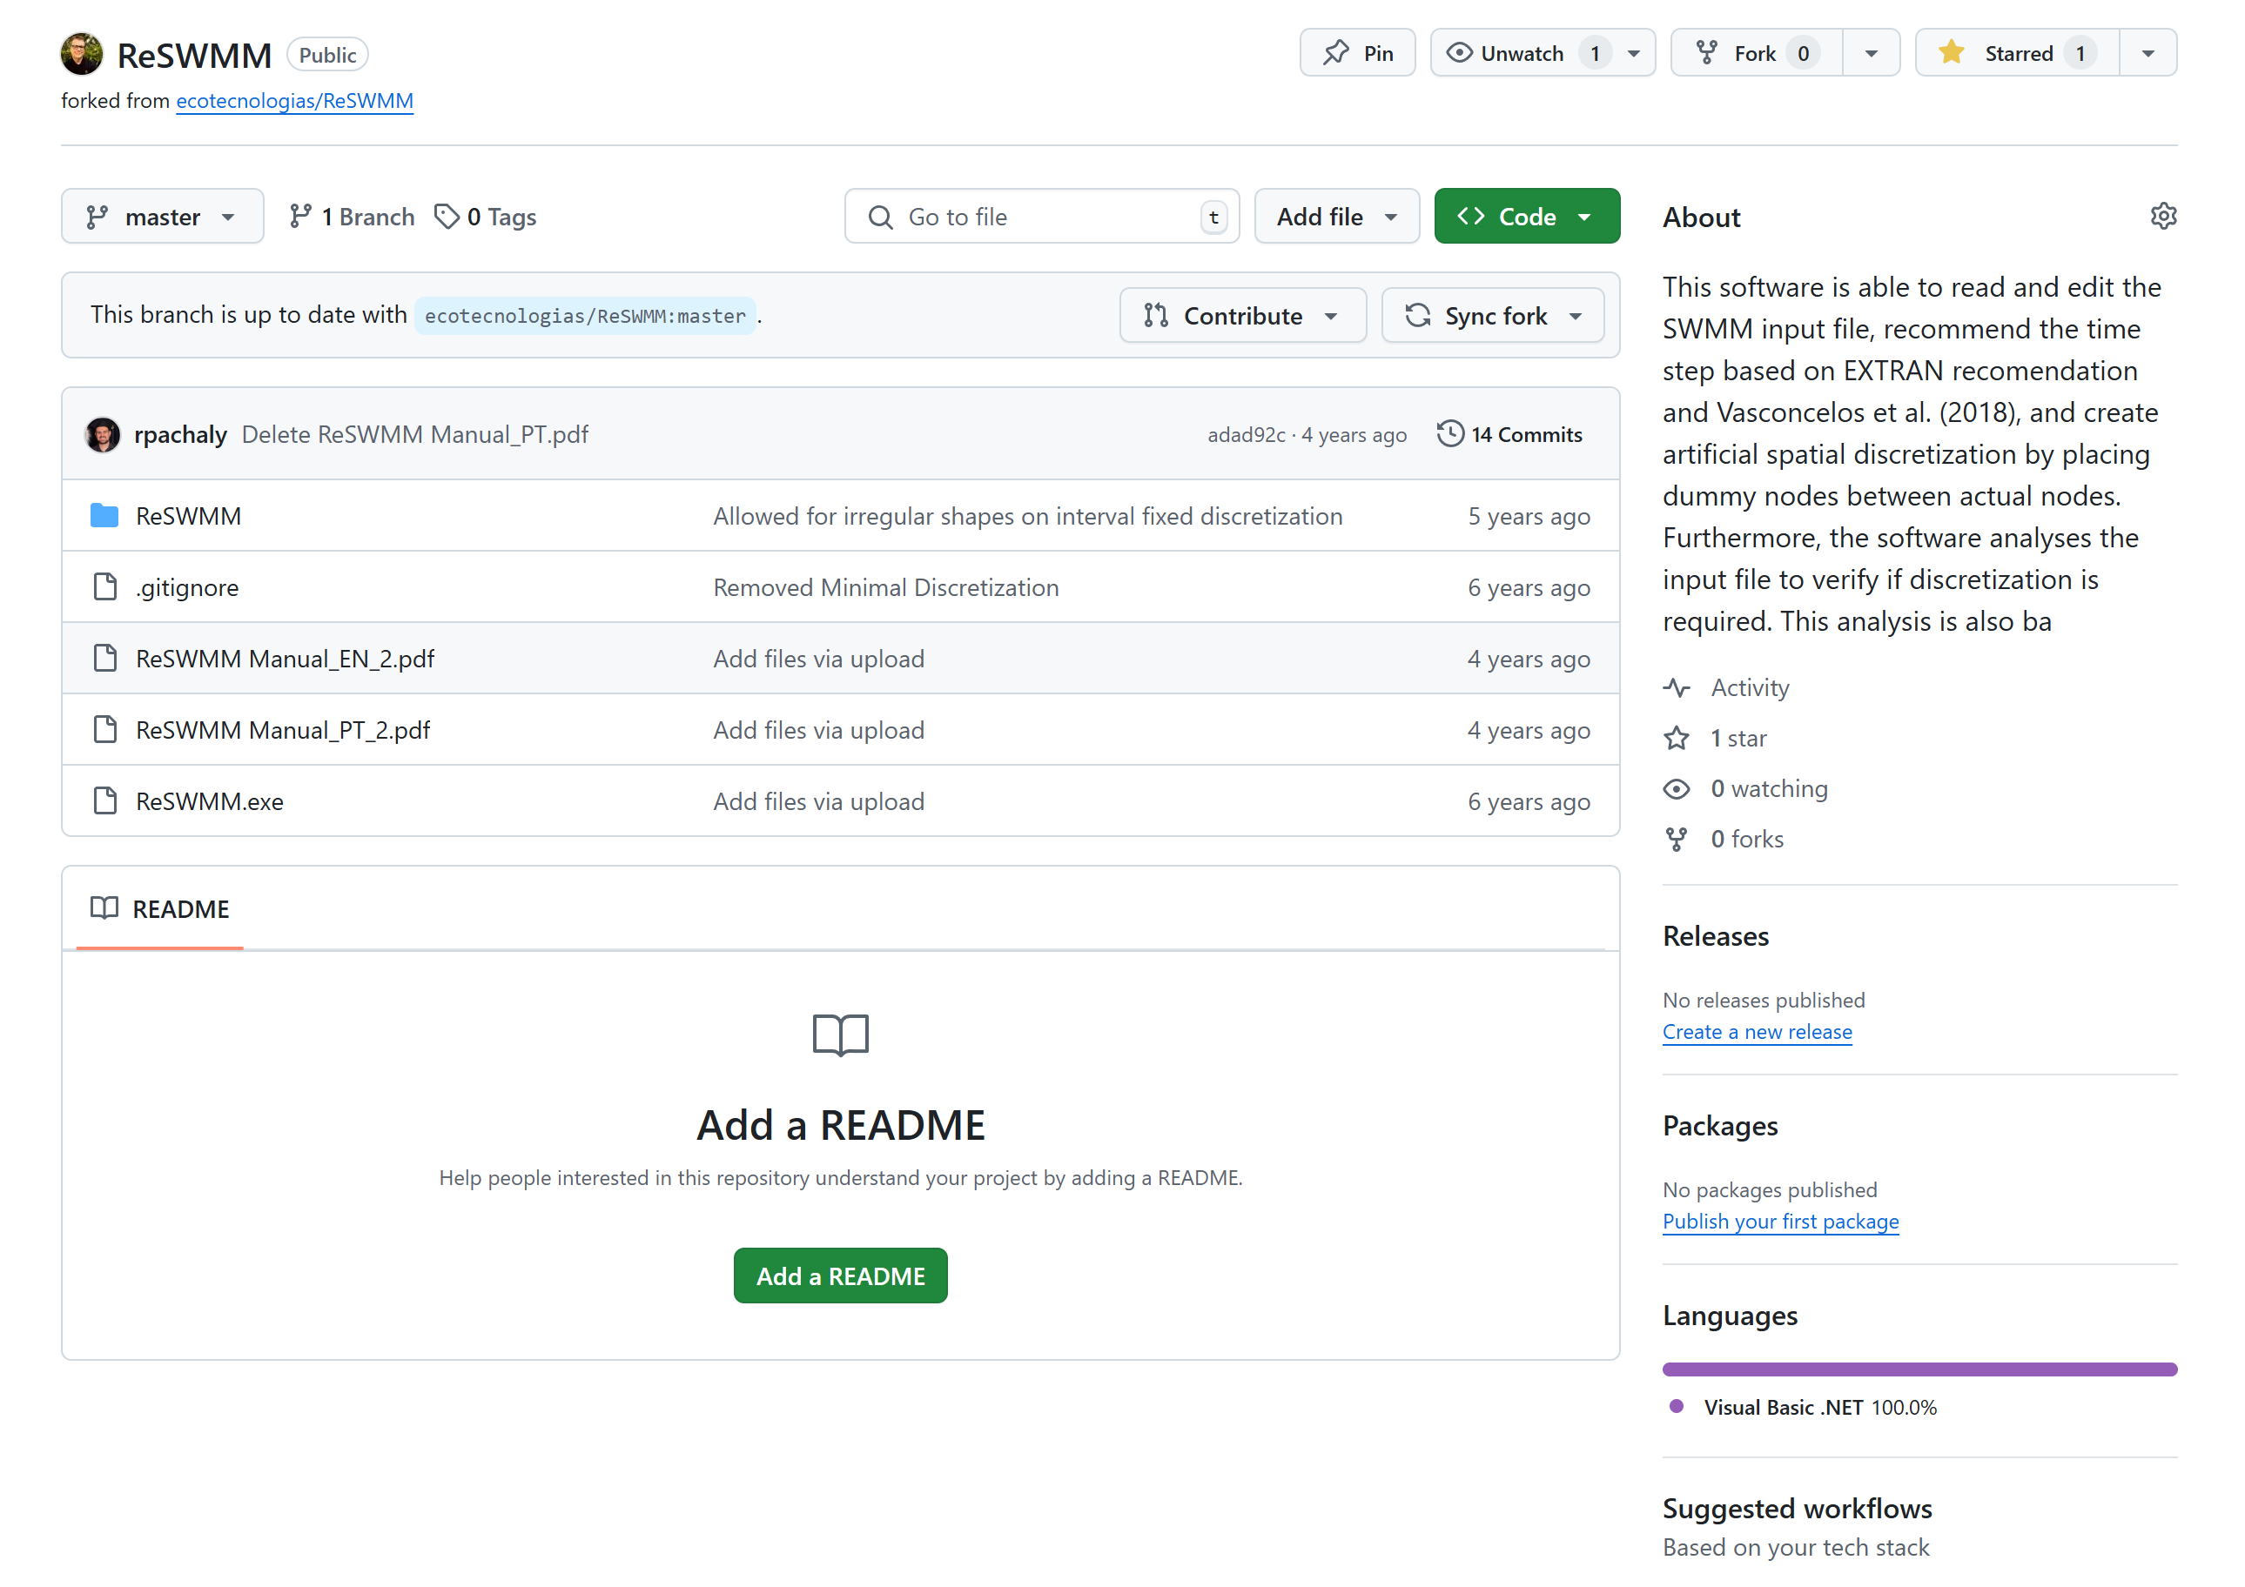
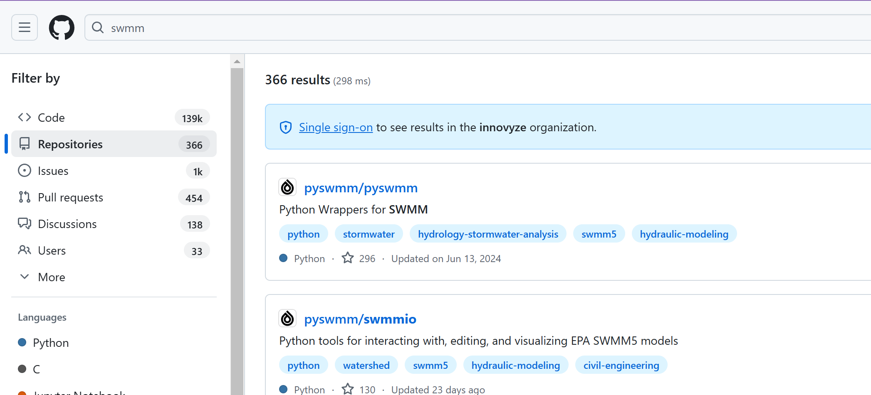
Third party GitHubs for SWMM5
Third party GitHub for SWMM5
ReSWMM
RSWMM

Slide 30
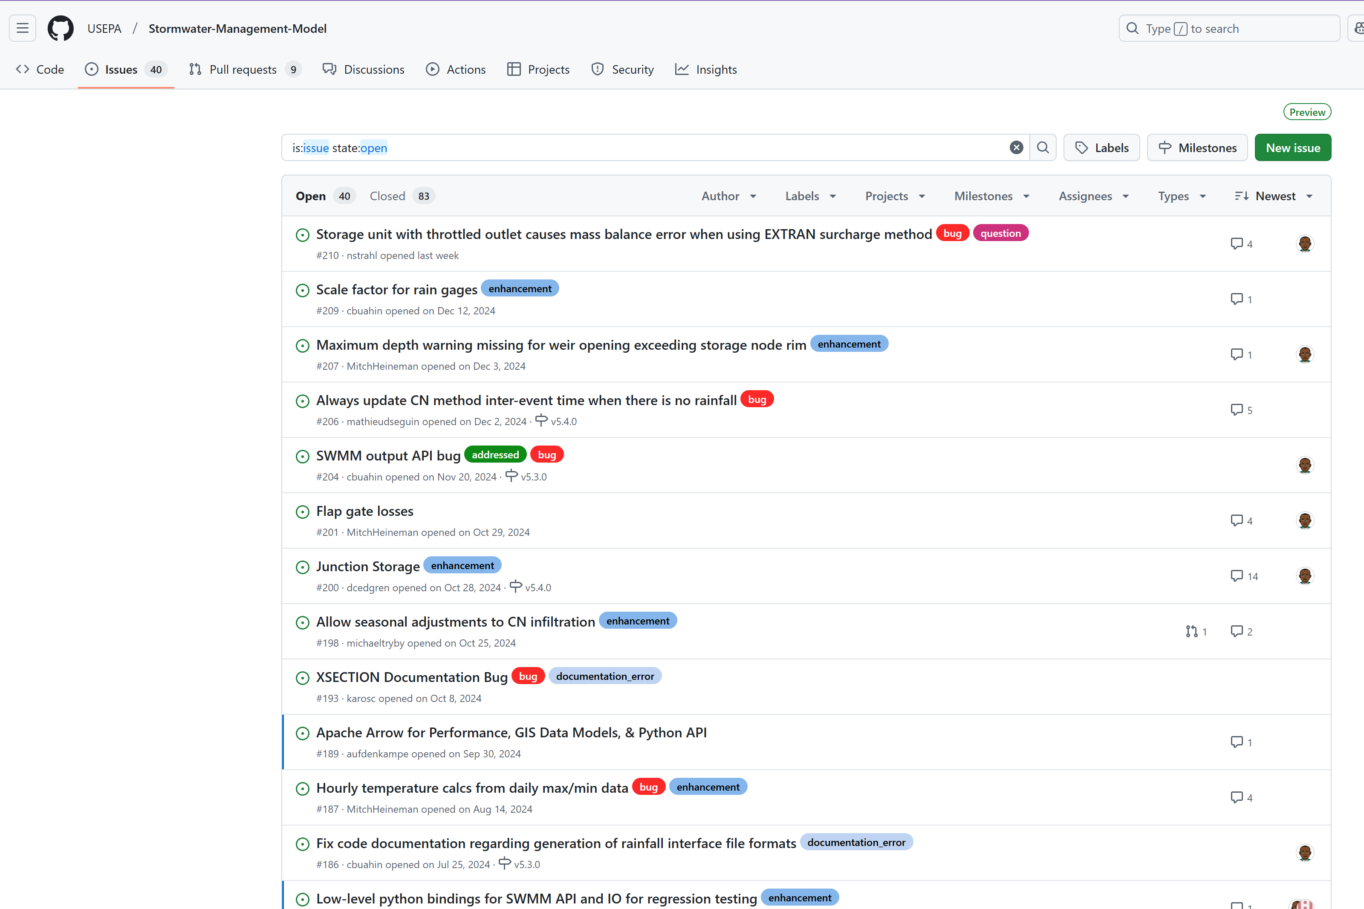
USEPA GitHub for SWMM5
https://github.com/USEPA/Stormwater-Management-Model
Purpose: This GitHub repository serves as the official platform for the source code, documentation, and related resources of the EPA Stormwater Management Model (SWMM5).

Slide 31
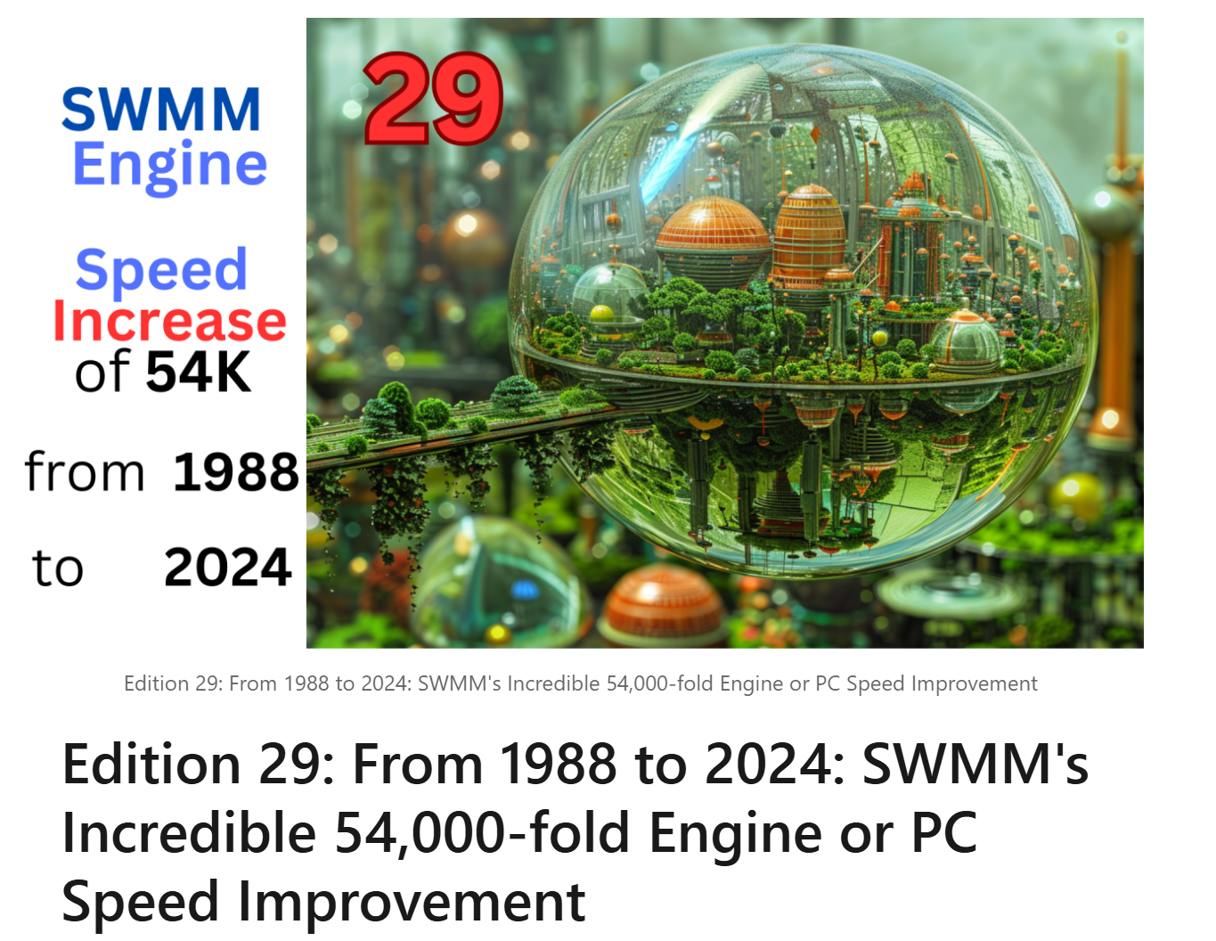
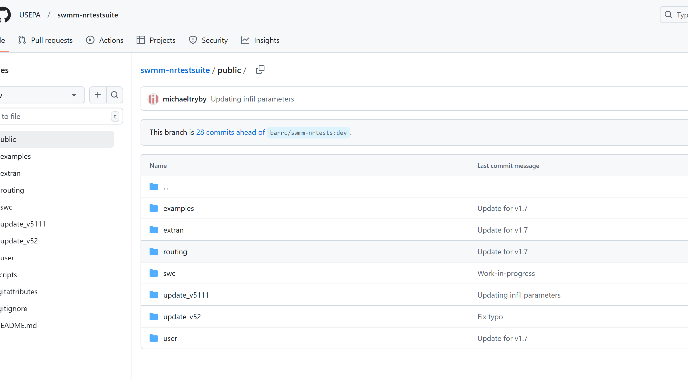
SWMM Test Suite for SWMM3,4,5 EPA GitHub

Slide 32
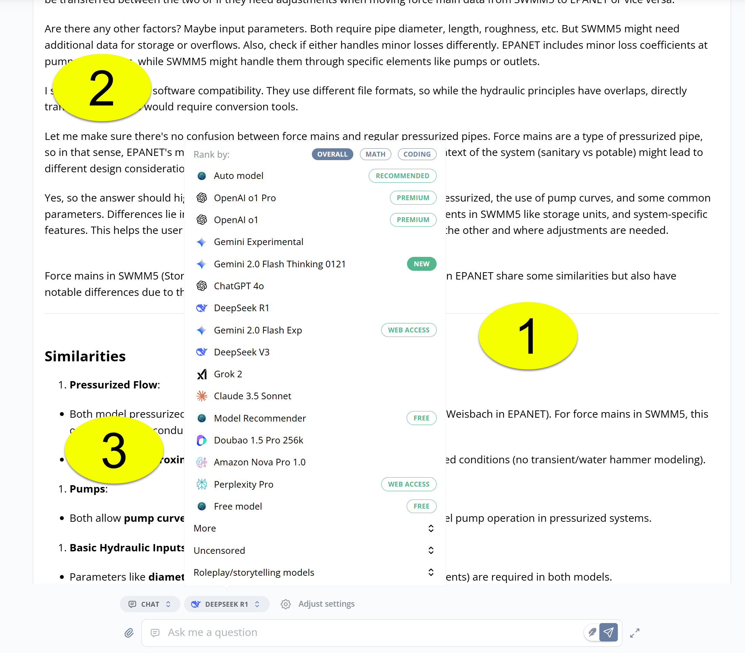
AI and SWMM5 – Useful and Knowledgeable
EPASWMM5 provides a well-defined, mathematically grounded representation of urban drainage systems, making it readily understandable and usable for AI applications in stormwater management.
Source Code is open source
Great Reference Manuals
Many Vendors
OpenSWMM.ORG
Many blogs and examples

Slide 33
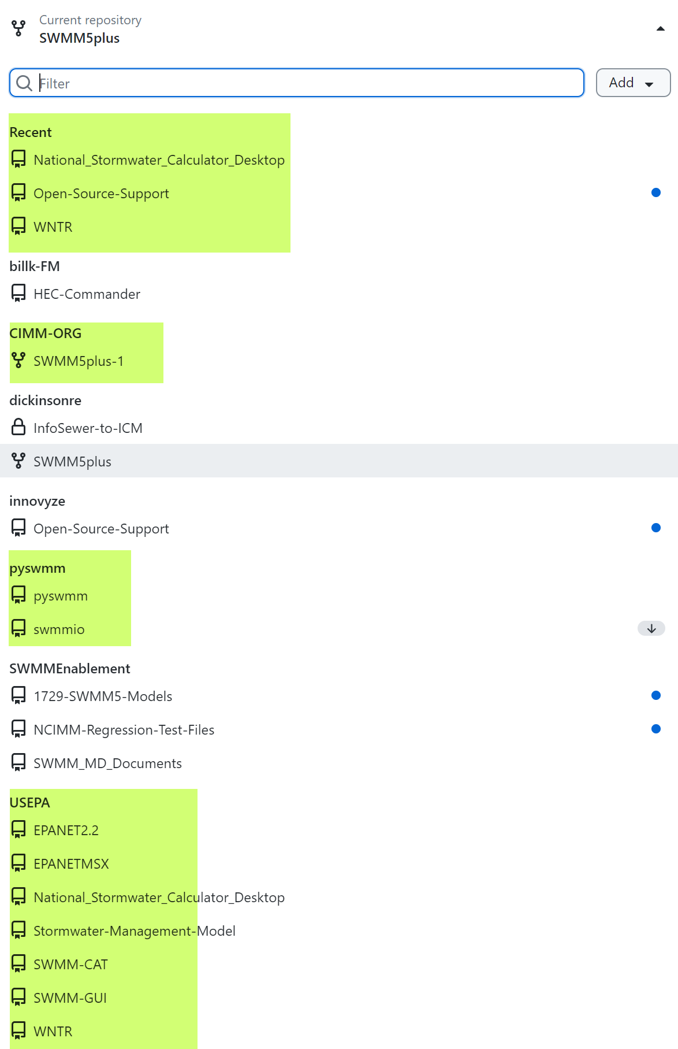
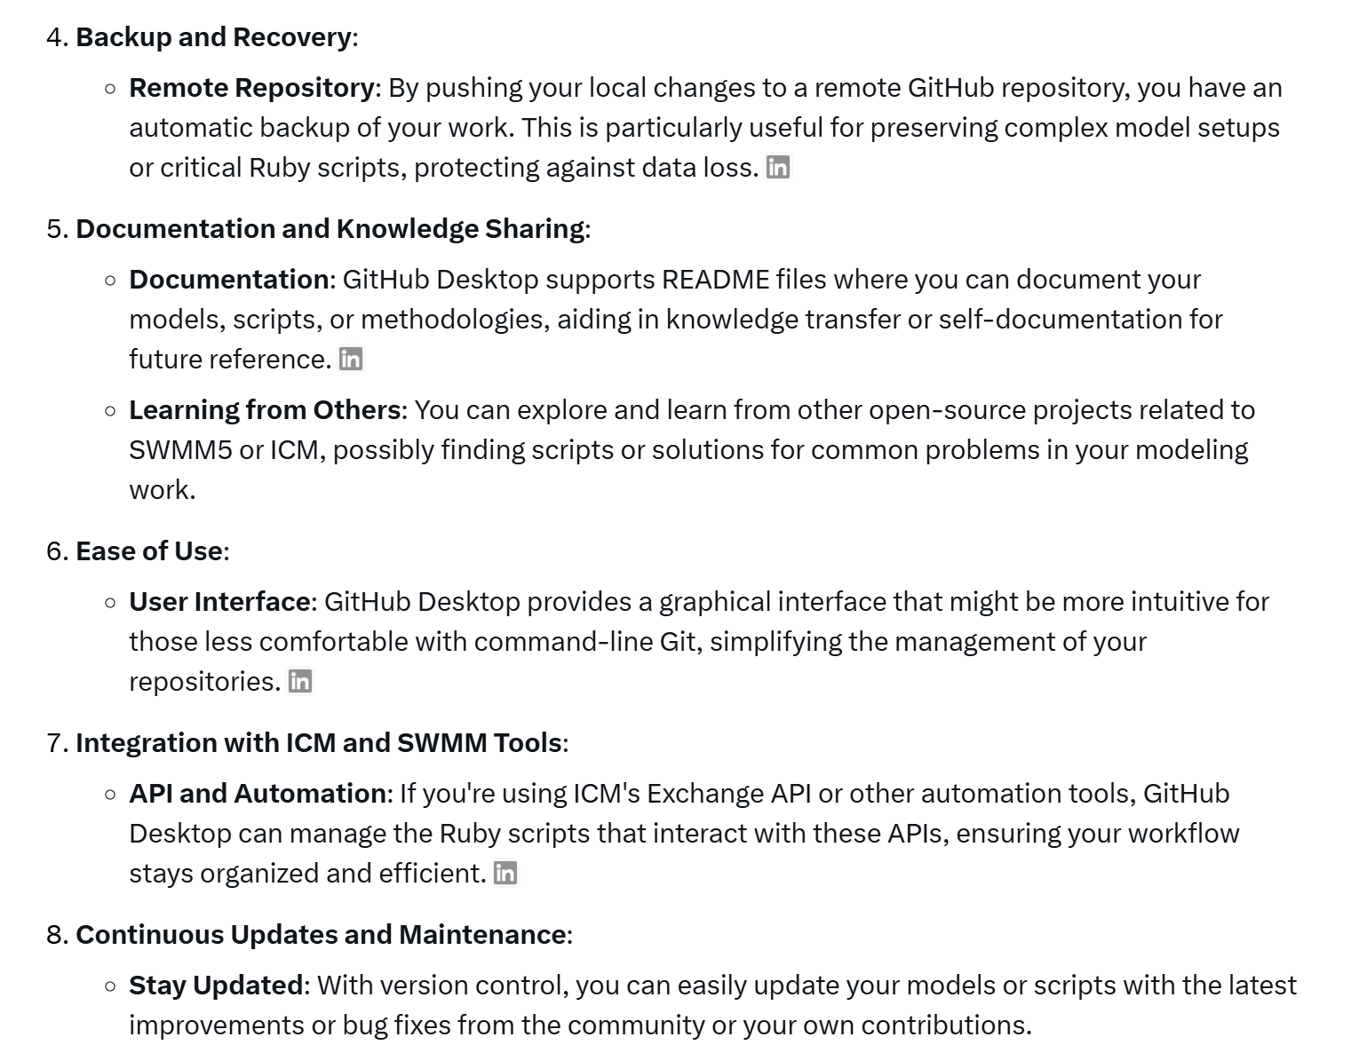
GitHub Desktop

Slide 34
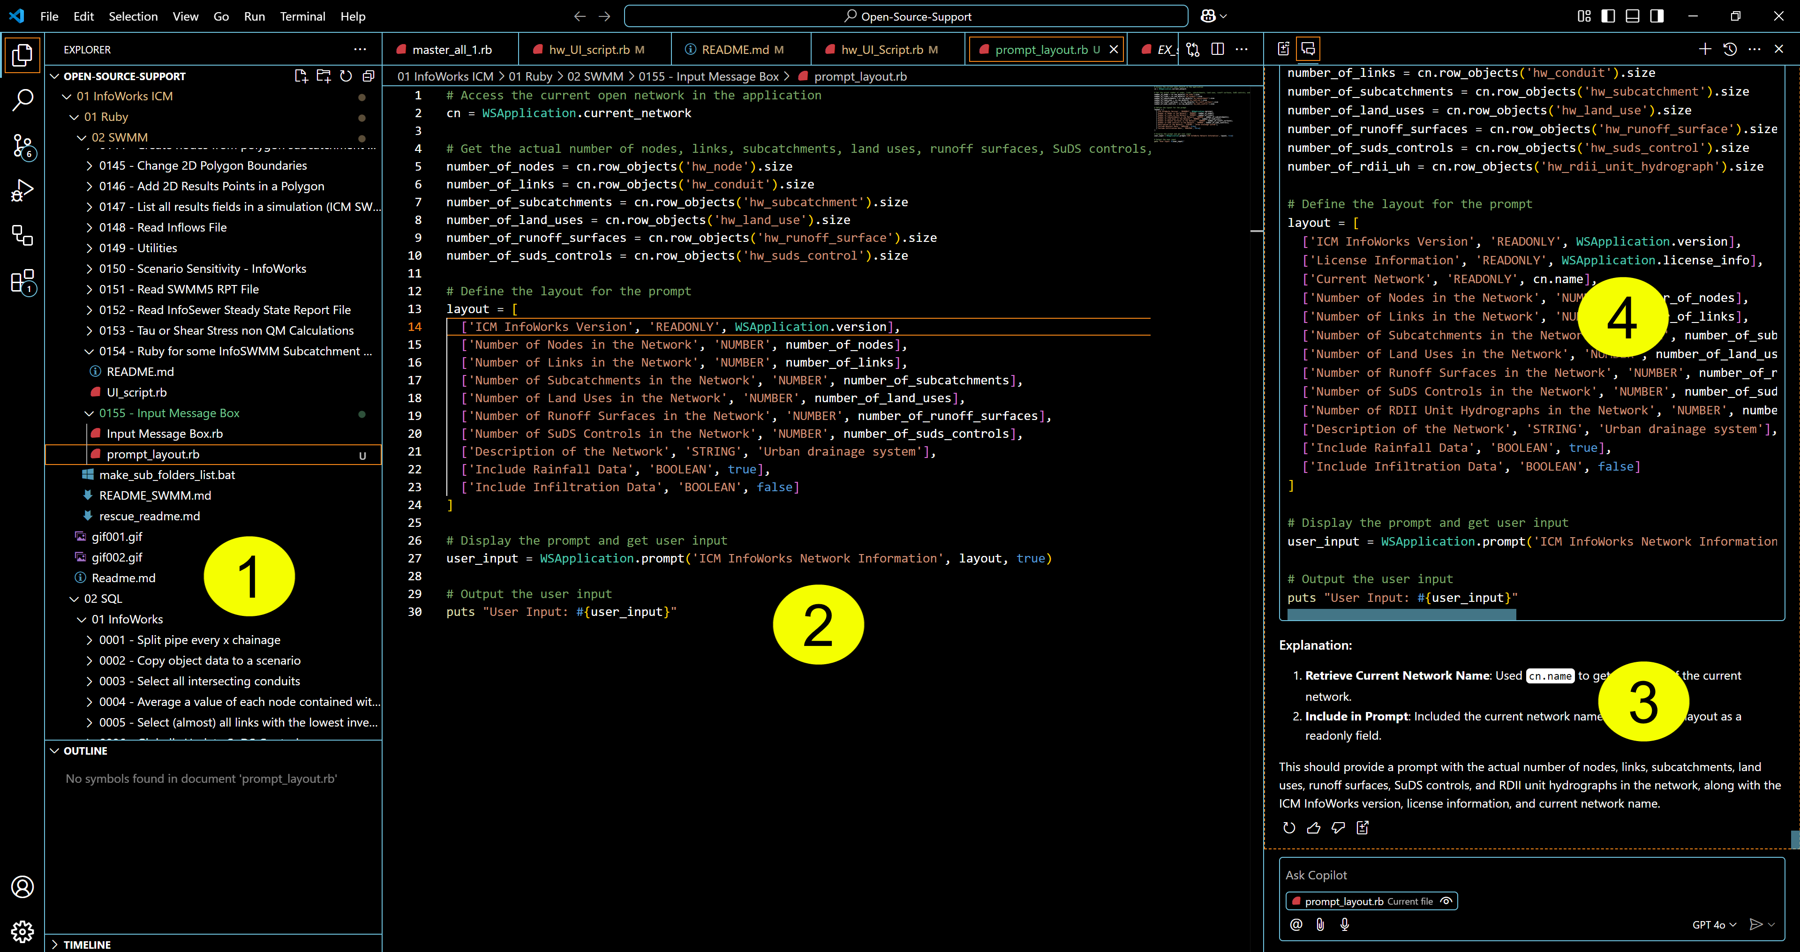
Visual Studio Code with GitHub CoPilot
The Files in your Repository-1
The code in the file-2
CoPilot questions-3
CoPilot Answers or Suggestions-4

Slide 35
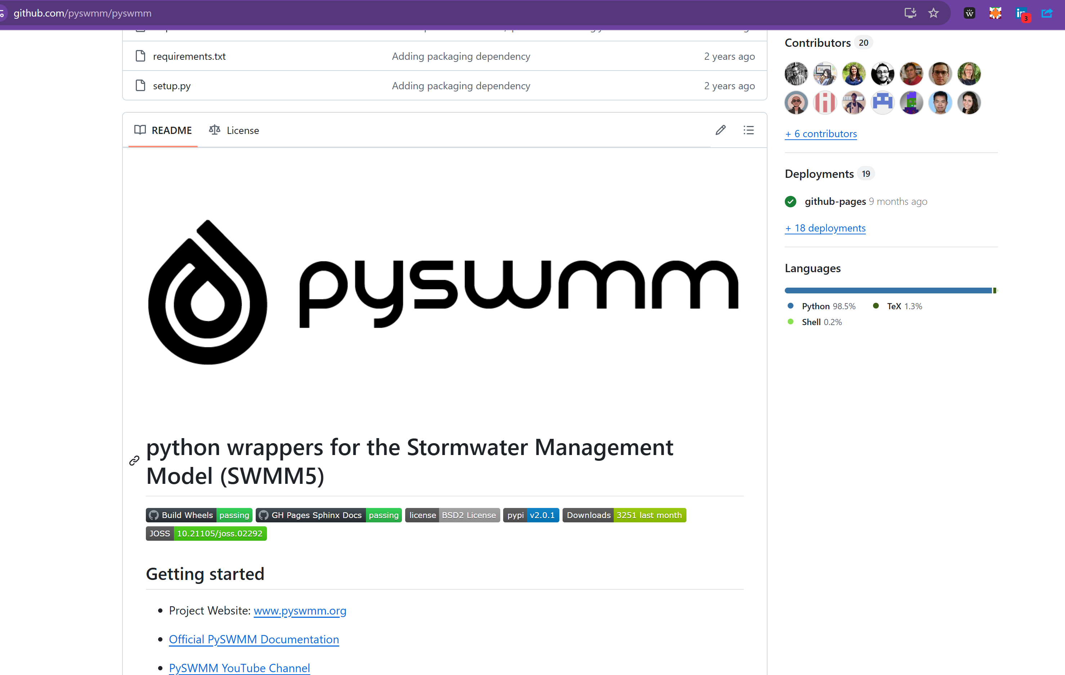
PySWMM
PySWMM started in 2014, with the first commit in May 2014. The 10th anniversary was celebrated in 2024 with version 2.0.0. It is a Python wrapper for SWMM, allowing interaction with the SWMM engine.
The 2023 release (1.5.1) introduced hotstart file handling, and version 2.0.0 in 2024 added more Pythonic data access and simulation state management.

Slide 36
Future Directions and Summary
Interested in diving deeper into the world of stormwater management simulation? Here's how you can get involved with the Storm Water Management Model (SWMM).
Explore SWMM Resources: Visit the EPA SWMM website to access tutorials, case studies, and the latest software releases. Enhance your understanding and application of SWMM in real-world scenarios.
Contribute to SWMM Development: If you have experience or an interest in hydrology, hydraulics, or software development, consider contributing to SWMM. Whether through bug reports, feature suggestions, or code contributions, your input can help shape the future of this vital tool. Check out the GitHub repository for more details on how you can get involved.
Engage with the Community: Join forums, discussion groups, or attend workshops where SWMM is discussed. Sharing knowledge, asking questions, and learning from others can significantly boost your expertise and keep you updated with the latest in stormwater management.

